Slide 1

DOMINICAN REPUBLIC
&
GUYANA
MISSION REPORT
July – Sep 2025

Slide 2

MISSION WORK
Mission work | Count
No. of Pastors | 17
Churches/Mission Field | 17
New Members added | 80
Baptism | 48
Bible Distribution | -
Church / School construction | -
Academic School / English School | 9
Academic / English School Teachers | 19

Slide 3
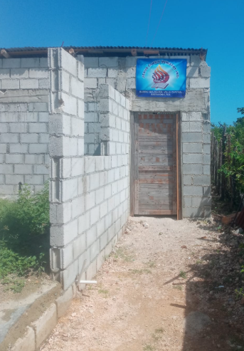
NEW CHURCH ADDED

Slide 4
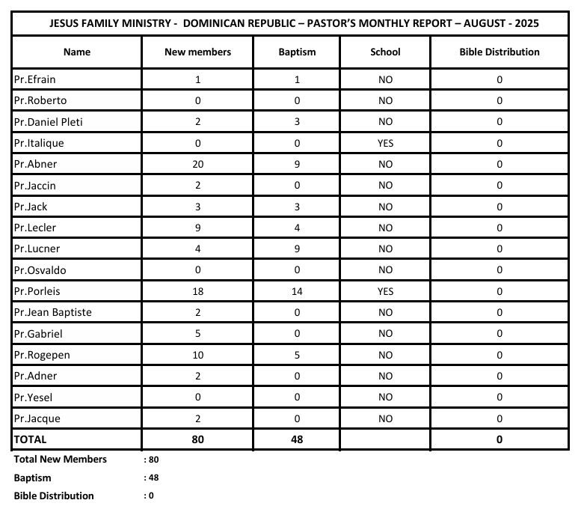
Monthly Pastor’s report

Slide 5
Pastor’s report
# | Pastor's Name | Place | No. of Members
1 | Pr. Lecler Garban | Garban - D.R | 69
2 | Pr. Jean Baptiste | Santa Maria – D.R | 60
3 | Pr. Jaccin | Paraiso – D.R | 50
4 | Pr. Efrain | Barahona – D.R | 40
5 | Pr. Gabriel | Bateq #6 – D.R | 70
6 | Pr. Lucner | Canoa – D.R | 80
7 | Pr. Daniel Pleti | Bateq Mena – D.R | 70
8 | Pr. Roberto | Bateq #4 – D.R | 40
9 | Pr. Osvaldo | Santa Maria – D.R | 30
10 | Pr. Rogener | Bateq #4 – D.R | 40
11 | Pr. Pauleus | Bateq #4 – D.R | 76
12 | Pr. Jague | Santa Maria – D.R | 60
13 | Pr. Abner | Piloncito – D.R | 40

Slide 6
Monthly TEACHER’S SUPPORT
Teacher’s Salary - Mountain School: $20 EACH Ms. Guerien Ketia, Ms. Louis Jean Linda, Ms. Louis Ommi | $ 60.00
Teacher’s Salary - Market School: $15 EACH Mr. Eltinus Enorc, Mr. Eltinus Luncler | $ 30.00
Teacher’s Salary - Cacique School: $15 EACH Mr. Delva Smith | $ 15.00
Teacher’s Salary - Gobe School: $15 EACH Mr. Charles Jatren, Mr. Vixemat Jonas | $ 30.00
Teacher’s Salary - Safary School: $15 EACH Mr. Rosmick December, Ms. Safary December | $ 30.00
Teacher’s Salary - Mathurin School 1: $15 EACH Mr. Evanus Octalus, Mr. Molier Esace, Mr. Sainvil Sonia, Mr. Joel Destine | $ 60.00
Teacher’s Salary - Mathurin School 2: $15 EACH Mr. Anilus Delva, Mr. Jean Pierre Baselois | $ 30.00
Teacher’s Salary - Olive School: $15 EACH Mr. Tertulien Claude, Mr. Felicie Poliscat | $ 30.00
Teacher’s Salary - Houdotte School: $15 EACH Mr. Yuette Polyte | $ 15.00

Slide 7
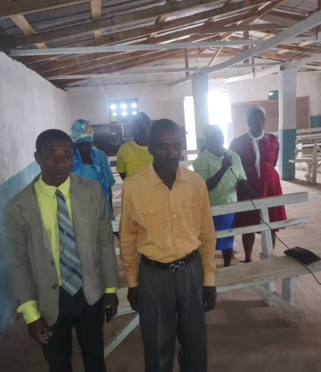
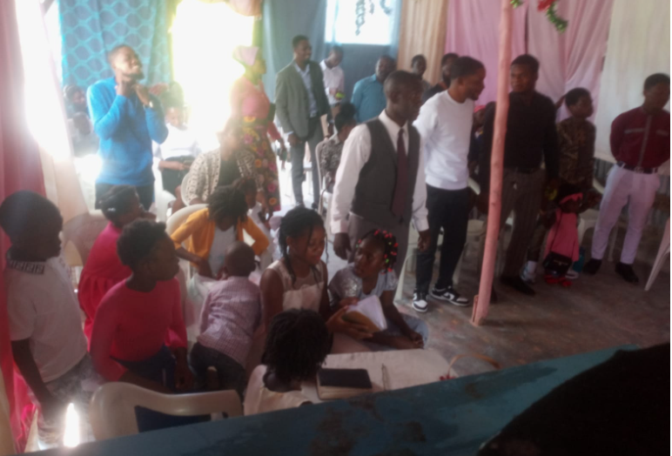
Church SERVICES

Slide 8
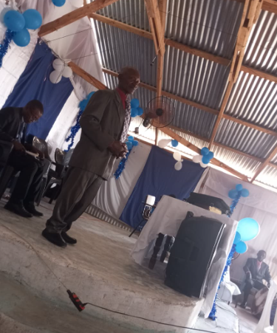
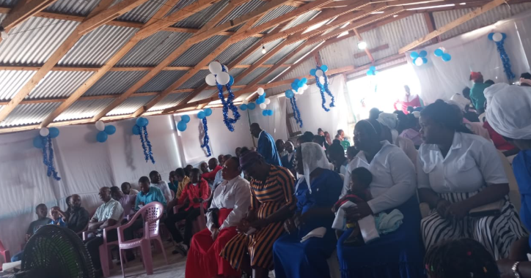
Church SERVICES

Slide 9
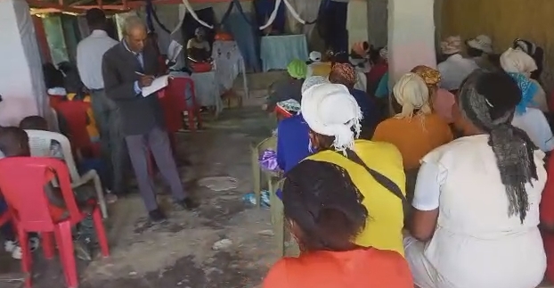
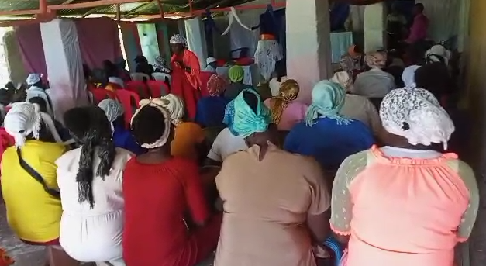
Church SERVICES

Slide 10
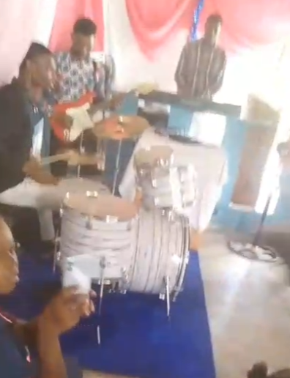
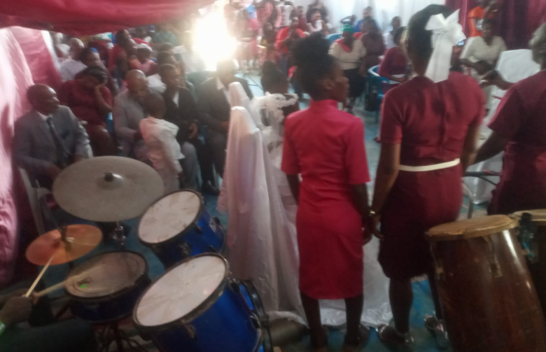
Church SERVICES

Slide 11
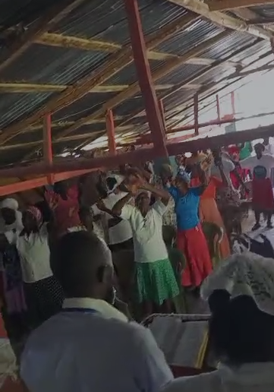
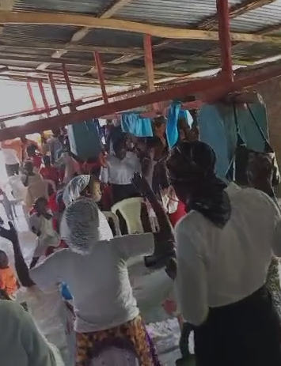
Church SERVICES

Slide 12
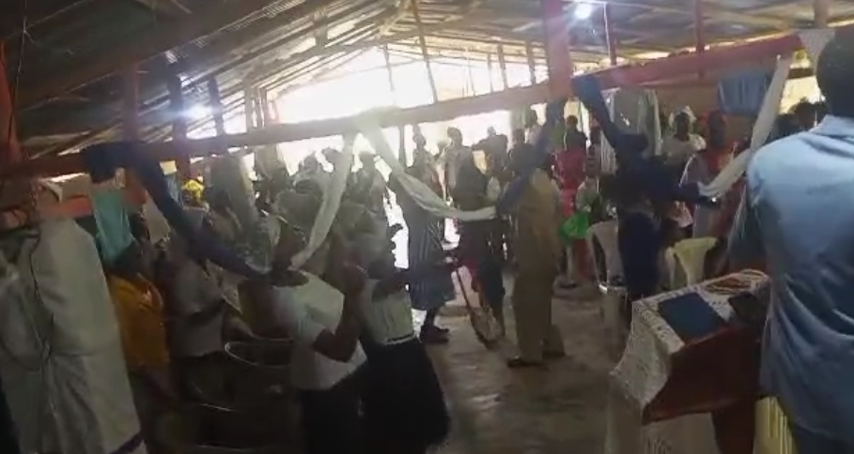
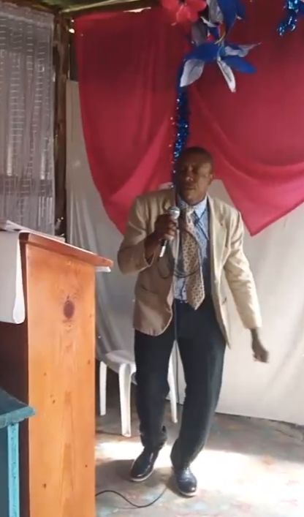
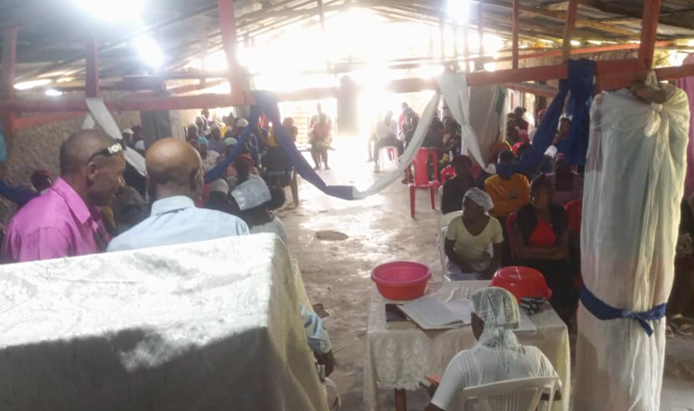
Church SERVICES

Slide 13
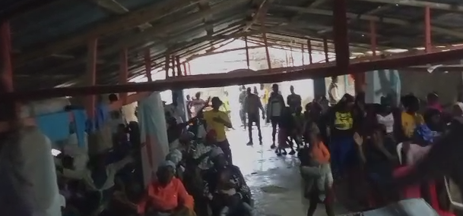
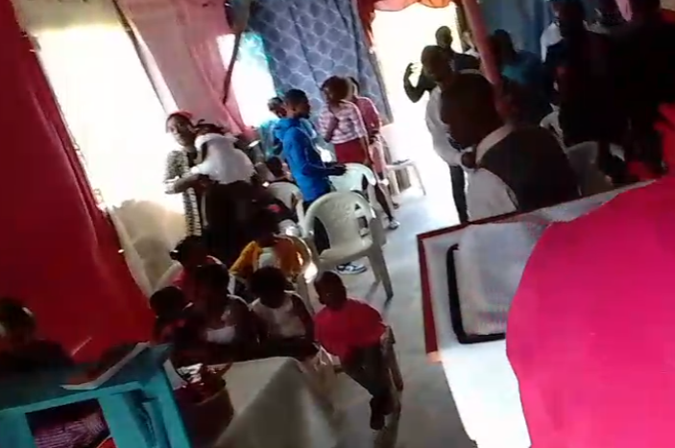
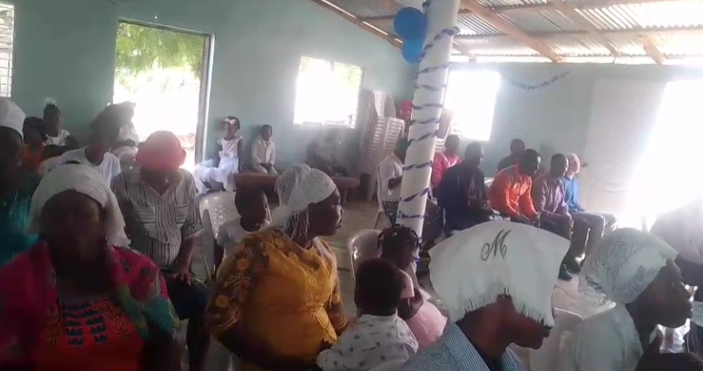
Church SERVICES

Slide 14
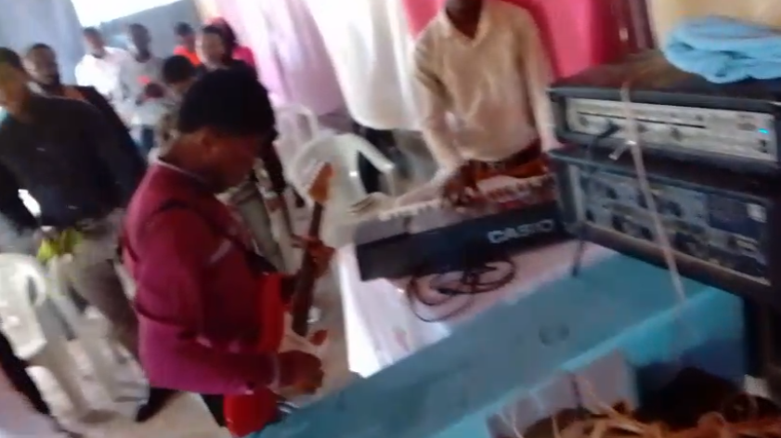
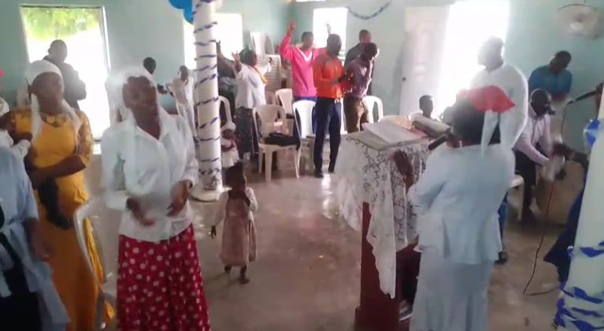
Church SERVICES

Slide 15
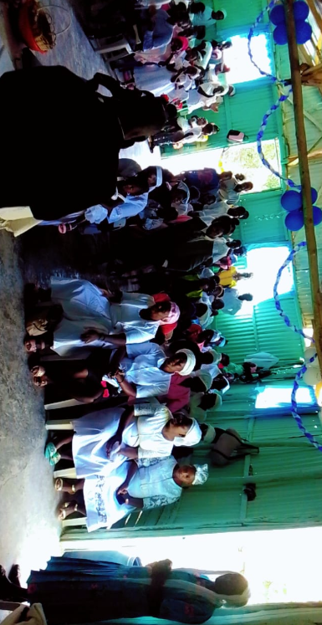
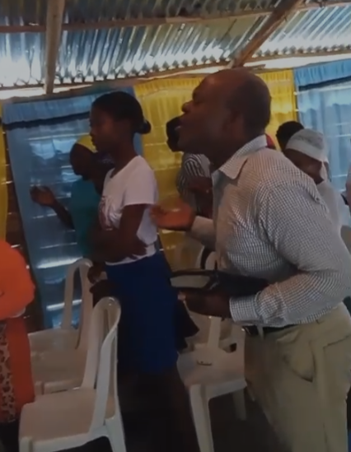
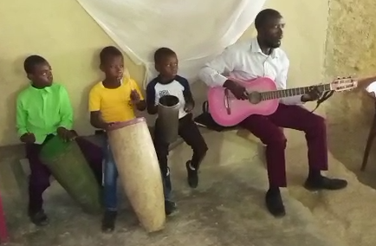
Church SERVICES

Slide 16
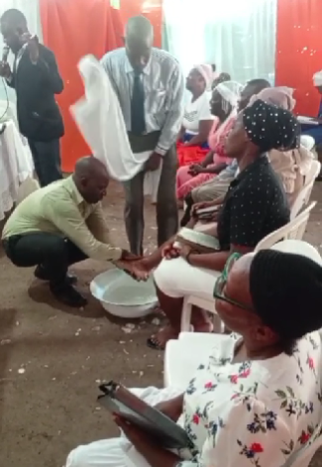
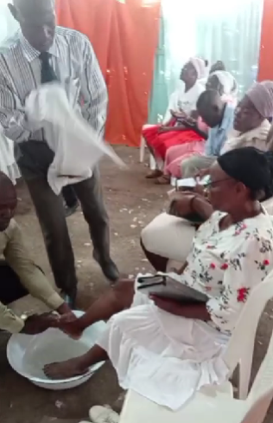
Church SERVICES

Slide 17
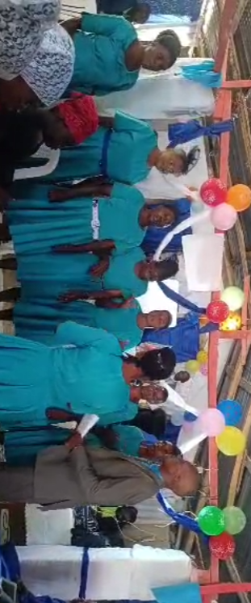
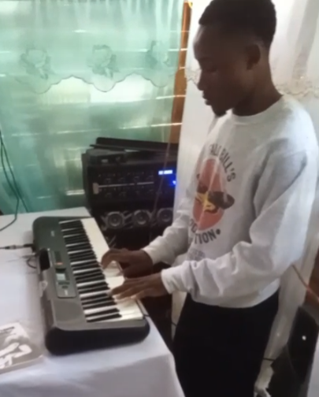
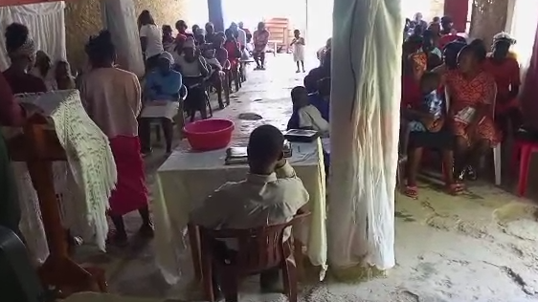
Church SERVICES

Slide 18
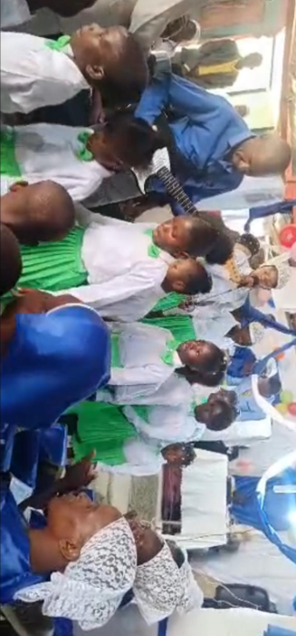
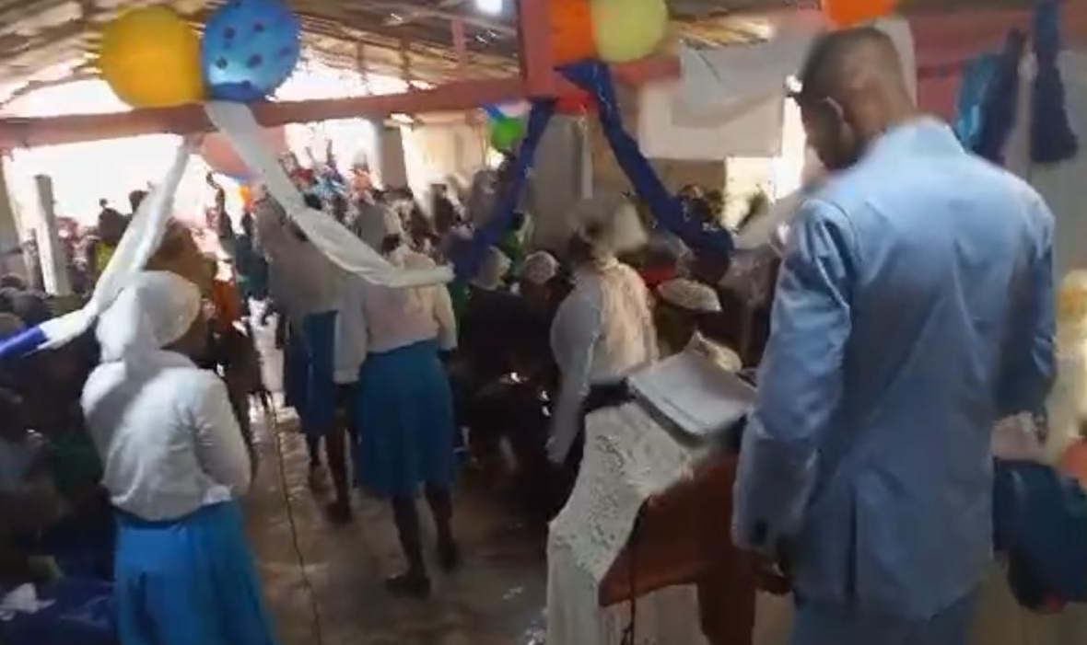
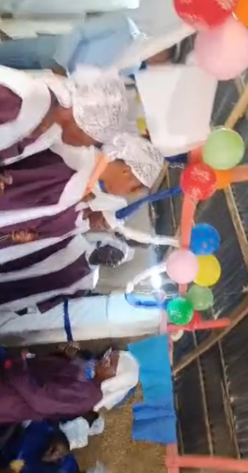
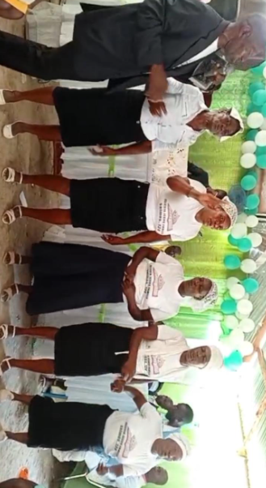
Church SERVICES

Slide 19
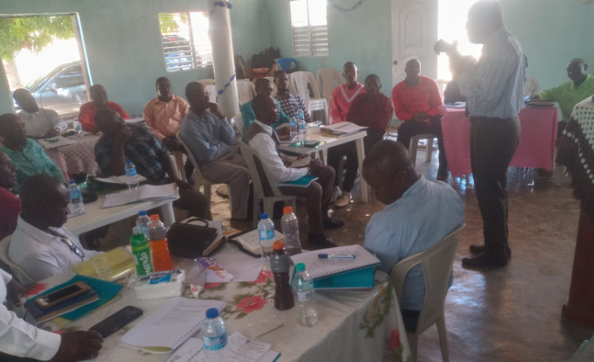
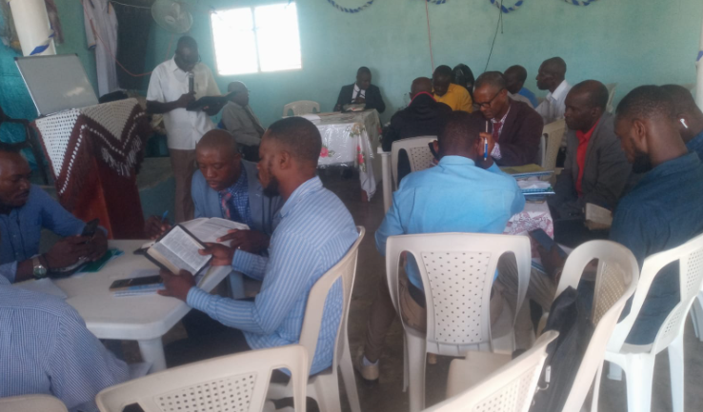
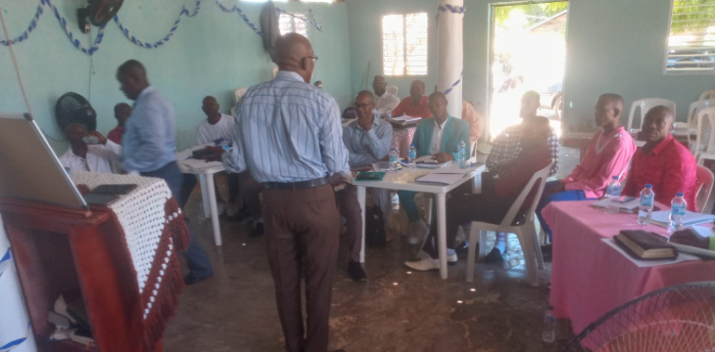
OTHER MEETINGS

Slide 20
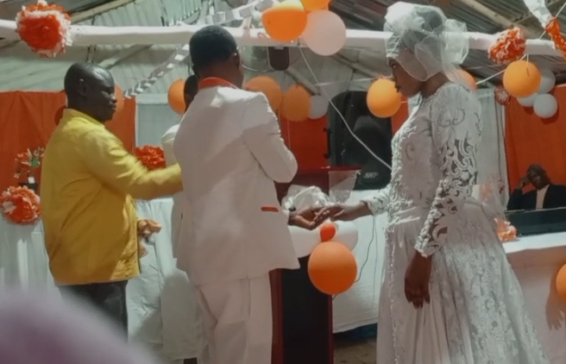
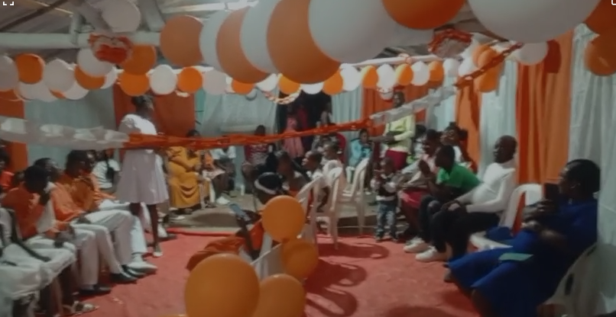
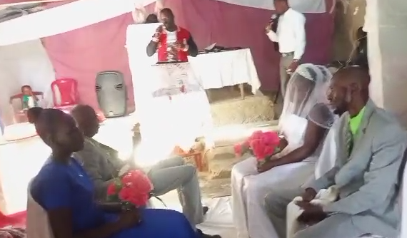
WEDDING SERVICES

Slide 21
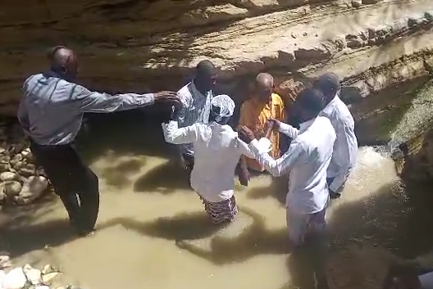
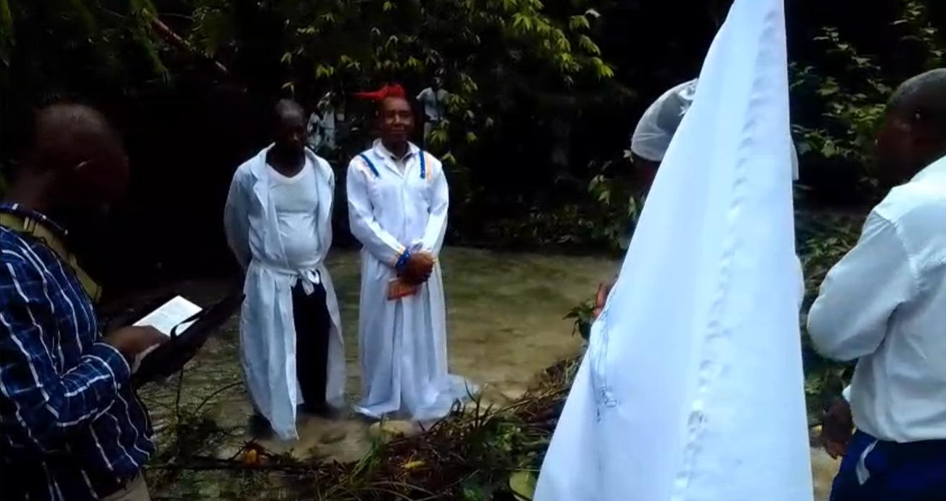
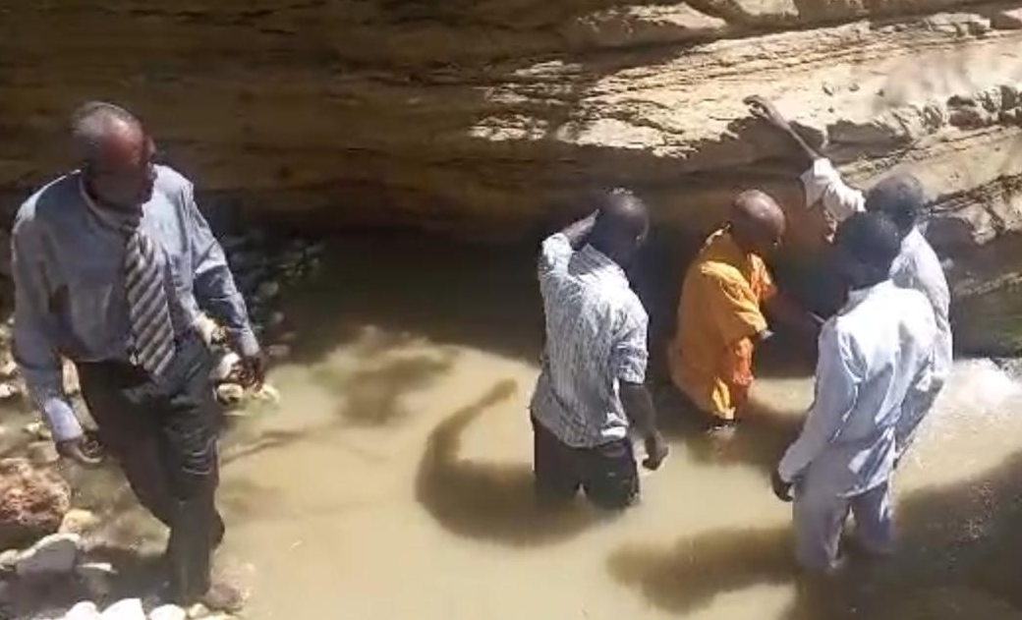
Baptism

Slide 22
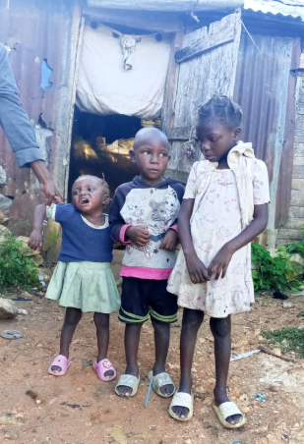
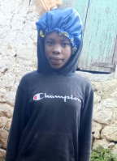
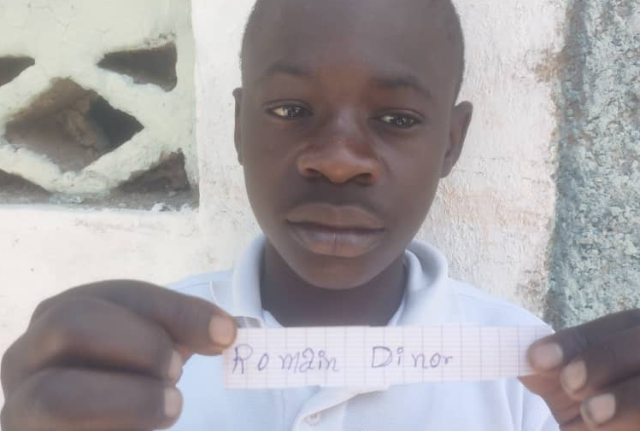
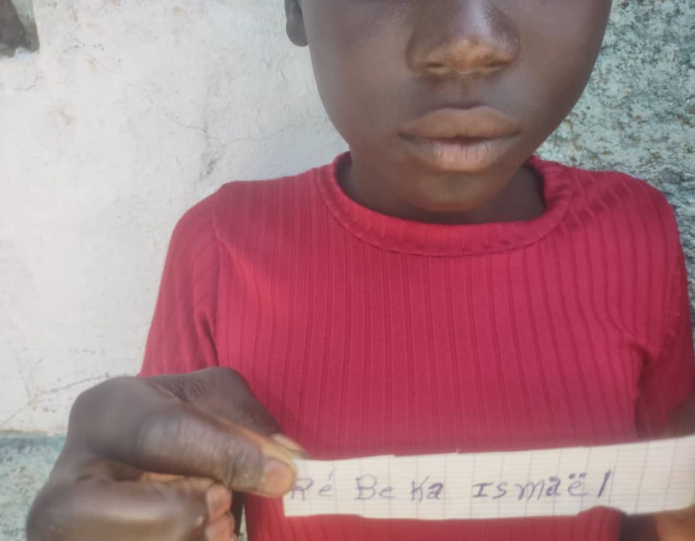
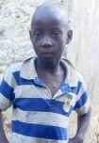
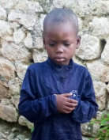
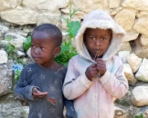
Orphan Kids support

Slide 23
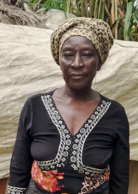
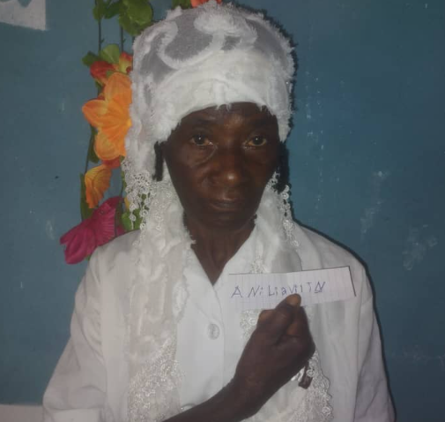



Widow/ELDERLY/poor people support

Slide 24






Widow/ELDERLY/poor people support

Slide 25









Widow/ELDERLY/poor people support

Slide 26






Widow/ELDERLY/poor people support

Slide 27








Widow/ELDERLY/poor people support

Slide 28



CHILDREN MINISTRY, Dominican Republic

Slide 29


OUTREACH MINISTRY, Dominican Republic

Slide 30


OUTREACH MINISTRY, Dominican Republic

Slide 31

Physically challenged orphan - support needed

Slide 32
GUYANA
MISSION REPORT
July – Sep 2025

Slide 33


GUYANA MINISTRY – COUPLES MEETING

Slide 34




GUYANA MINISTRY – KIDS OUTREACH

Slide 35

GUYANA KIDS MINISTRY – July vbs

Slide 36

GUYANA KIDS MINISTRY

Slide 37
PRAYER needs – Dominican republic
Request for chairs for churches
Physically challenged orphan boy support
Pray for the school ministry, teachers and students
Pray for all kids/widows/poor/elderly people being supported.
PRAYER needs - guyana
Pray for every child who heard the gospel to be saved.
Pray for all the outreach ministries and everyone who is involved

