Slide 1


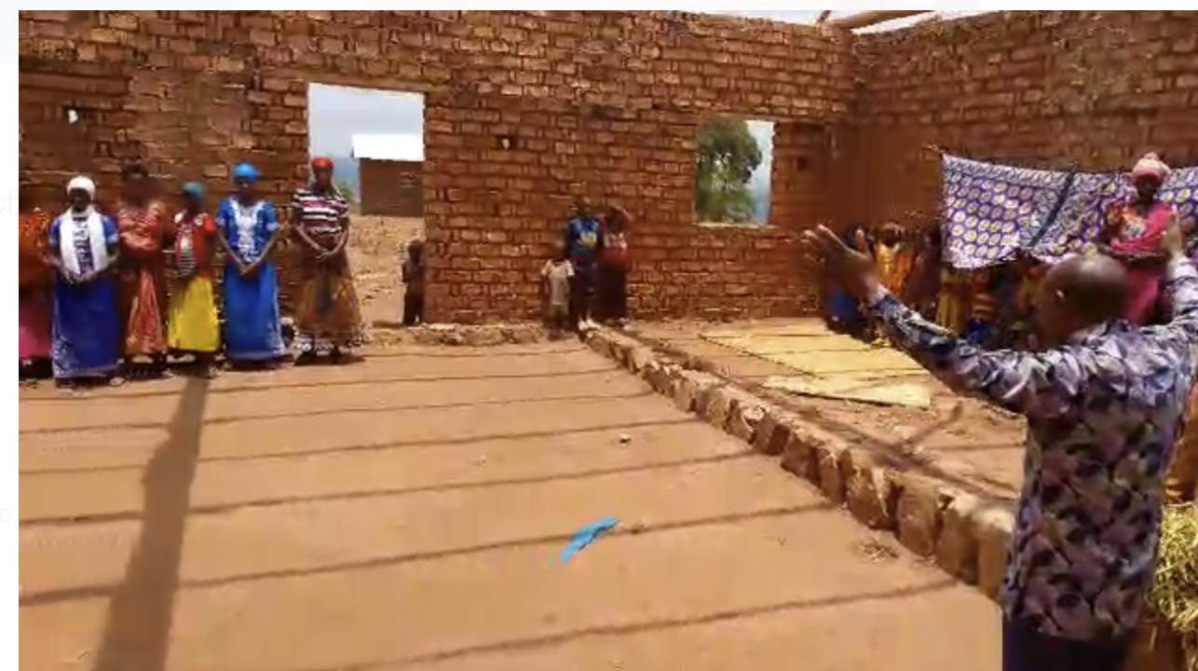
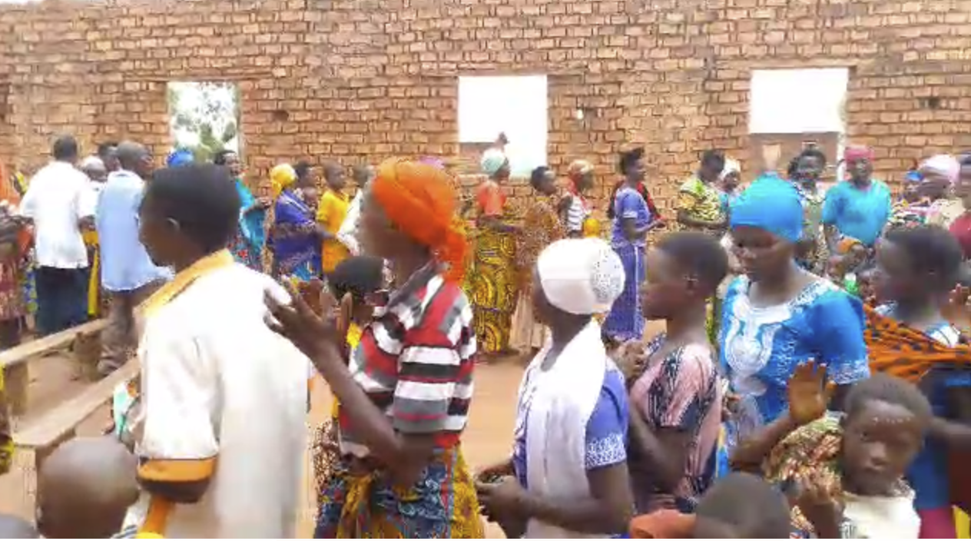

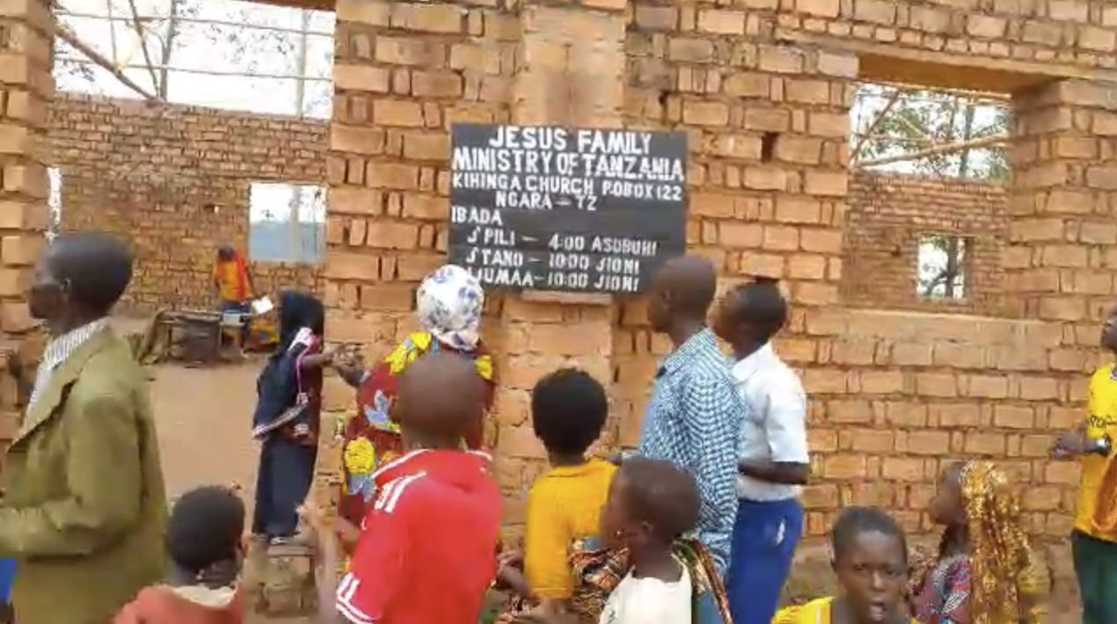
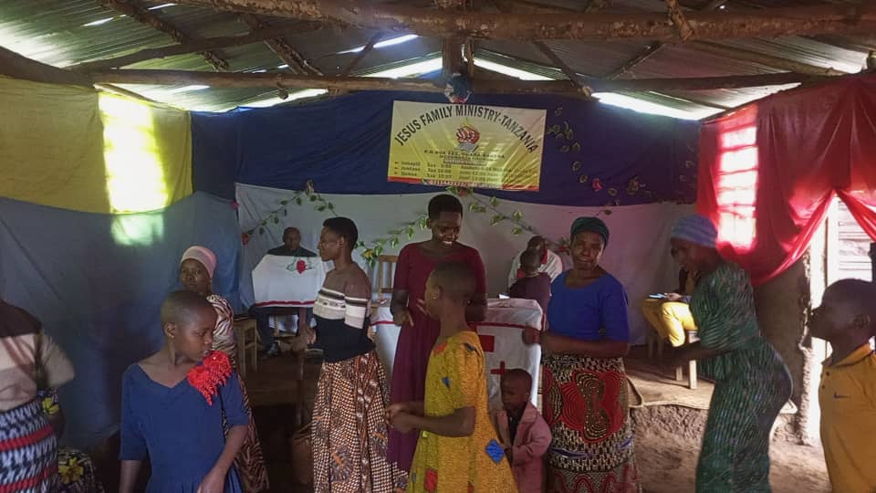
TANZANIA CHURCH MINISTRY
951 West Side Avenue,
JERSEY CITY, NJ- 07306
East Africa
May 2025

Slide 2
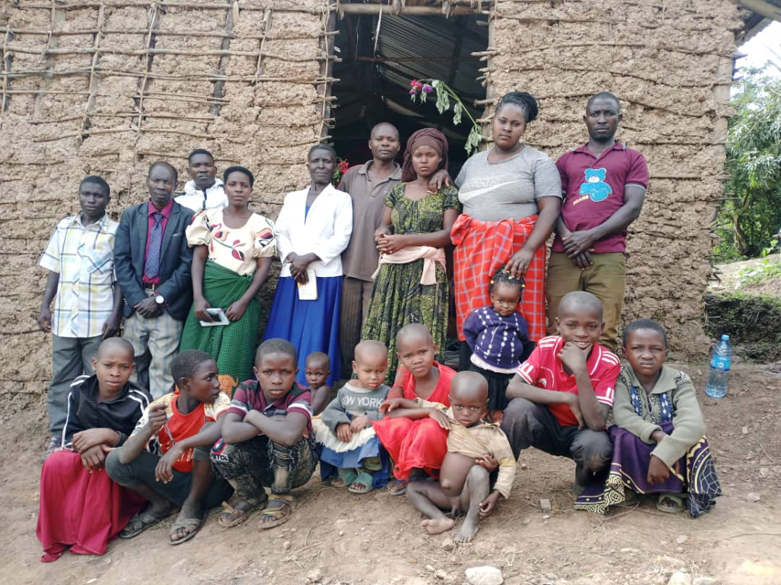
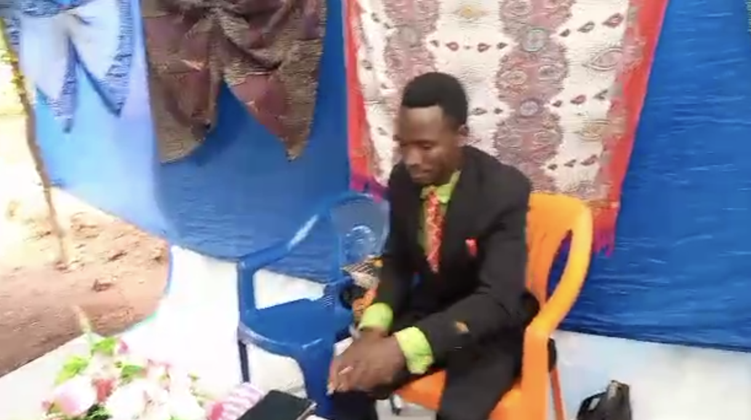

NEW CHURCH
Kayanga
Kakonko Church 1
951 West Side Avenue,
JERSEY CITY, NJ- 07306
Kakonko Church 2
East Africa
May 2025

Slide 3
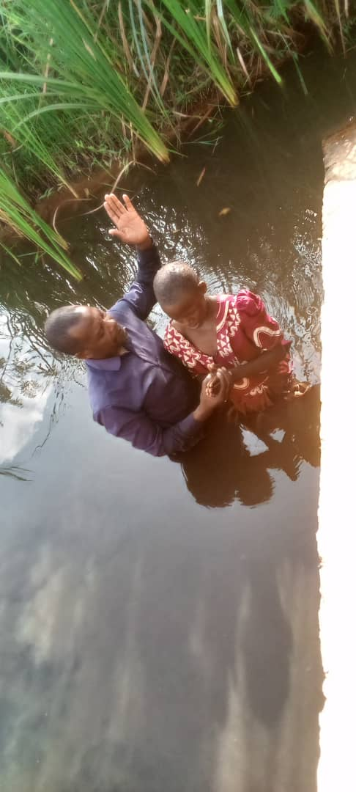
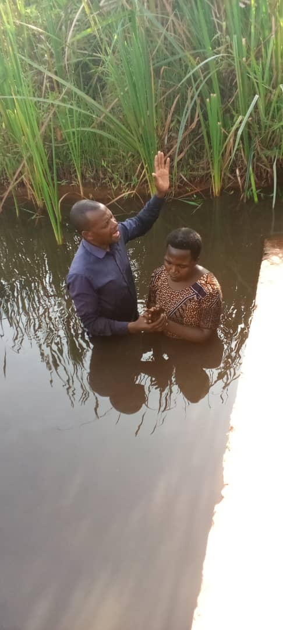
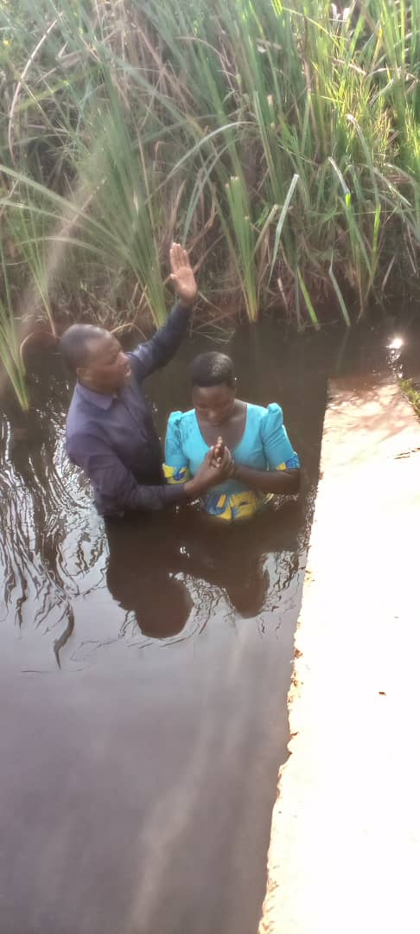
BAPTISM
951 West Side Avenue,
JERSEY CITY, NJ- 07306
42
3
242
-
East Africa
-
-
May 2025

Slide 4
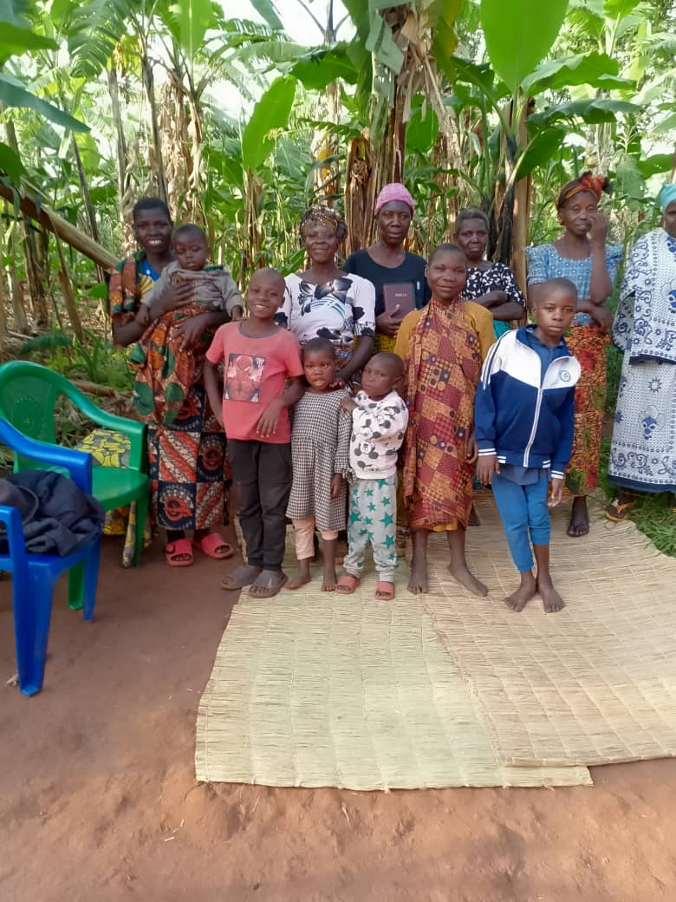
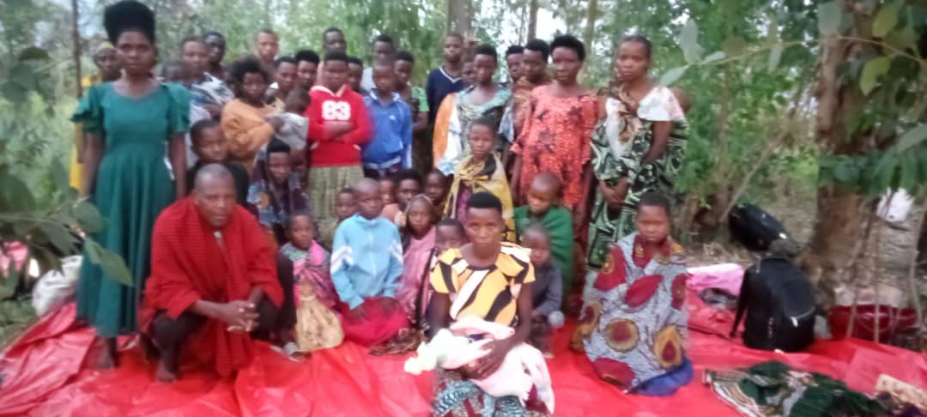
BIBLE STUDY
951 West Side Avenue,
JERSEY CITY, NJ- 07306
OUTREACH
East Africa
May 2025

Slide 5
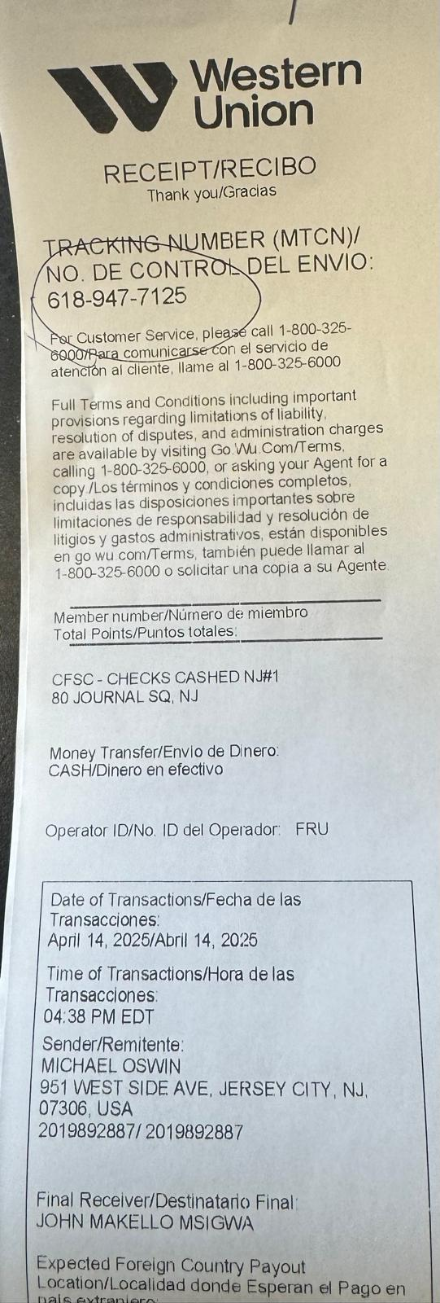
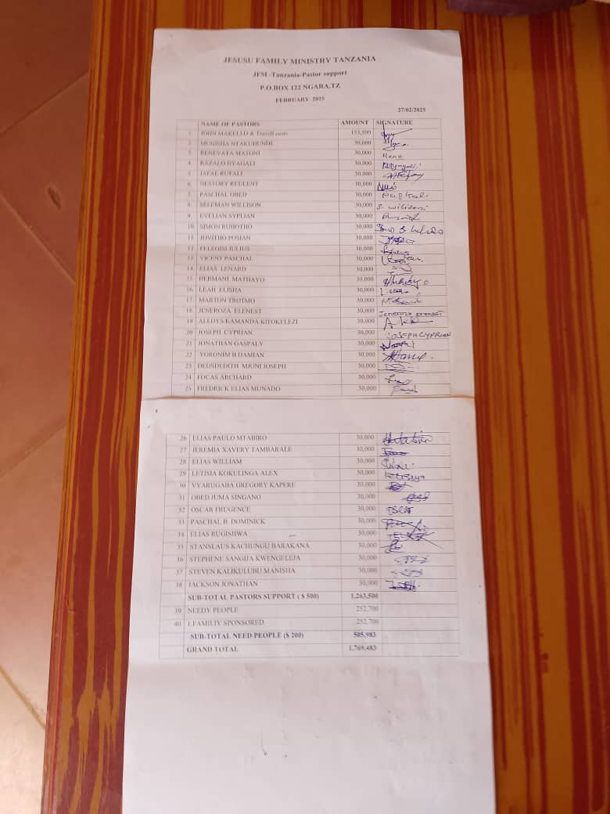
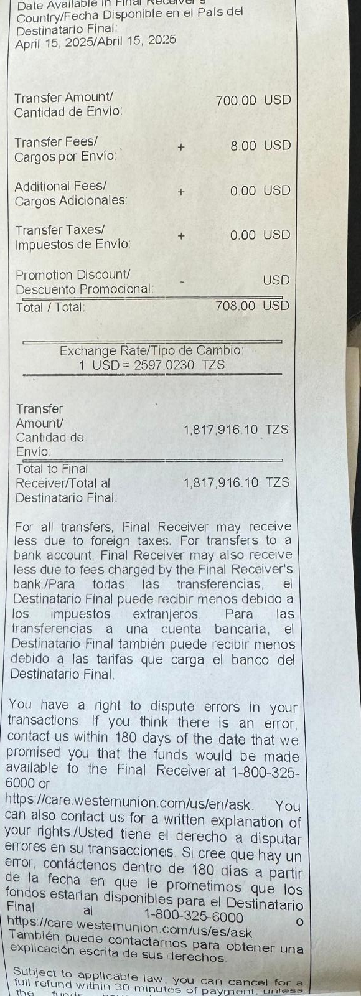
PASTOR SUPPORT
$30-$40
951 West Side Avenue,
JERSEY CITY, NJ- 07306
East Africa
May 2025

Slide 6
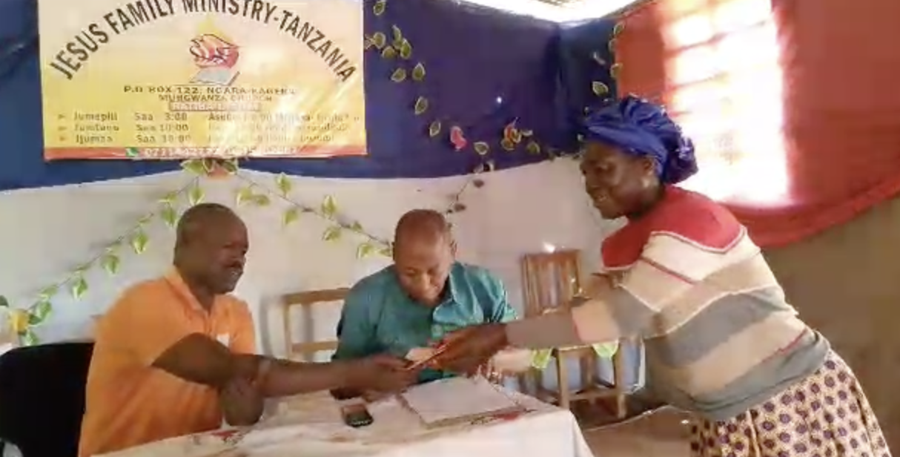
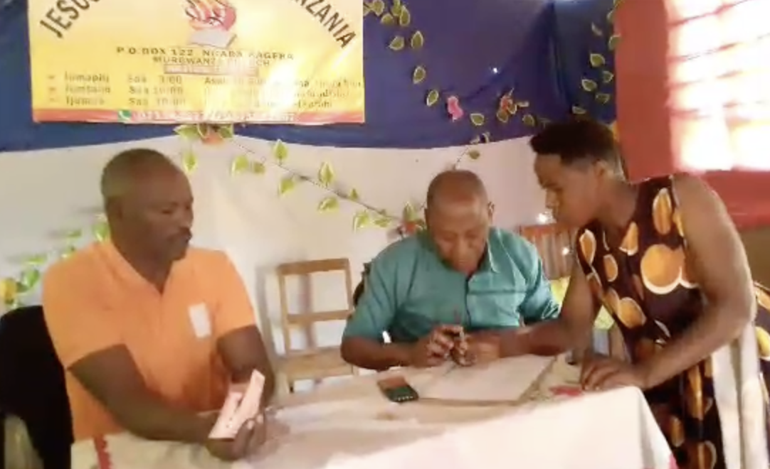
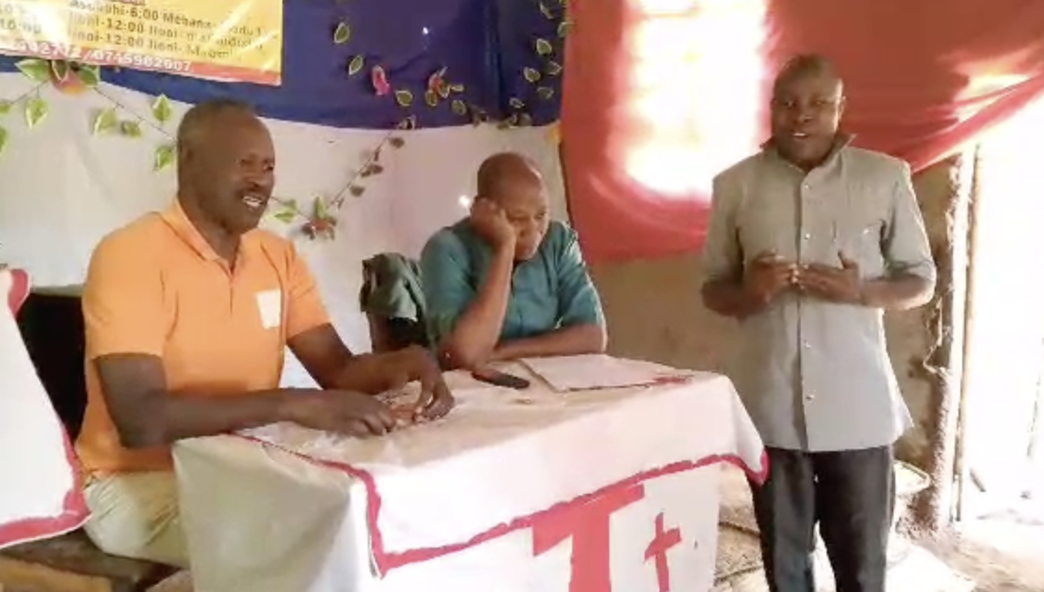
PASTOR SUPPORT
951 West Side Avenue,
JERSEY CITY, NJ- 07306
$30-$40
East Africa
May 2025

Slide 7
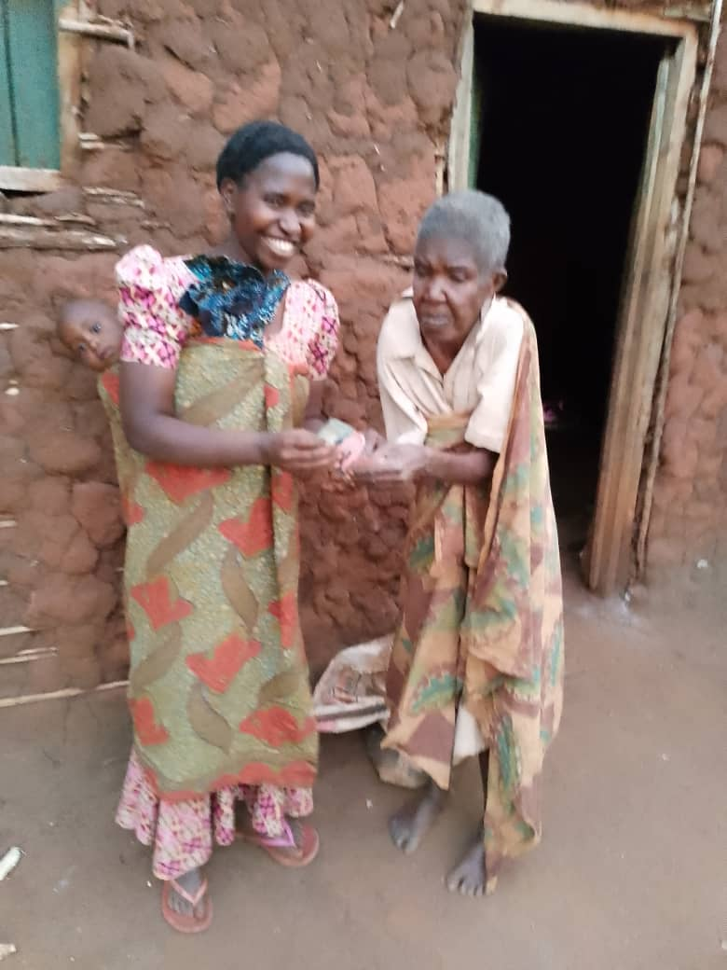
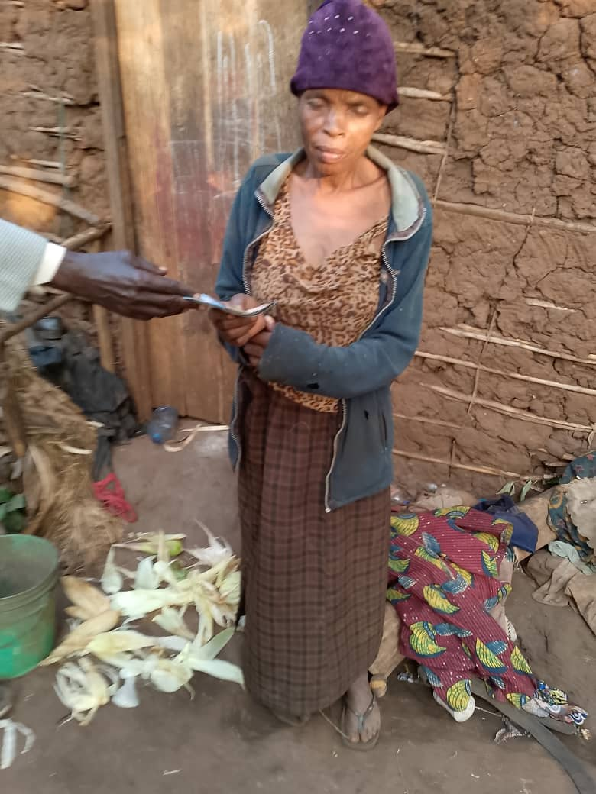
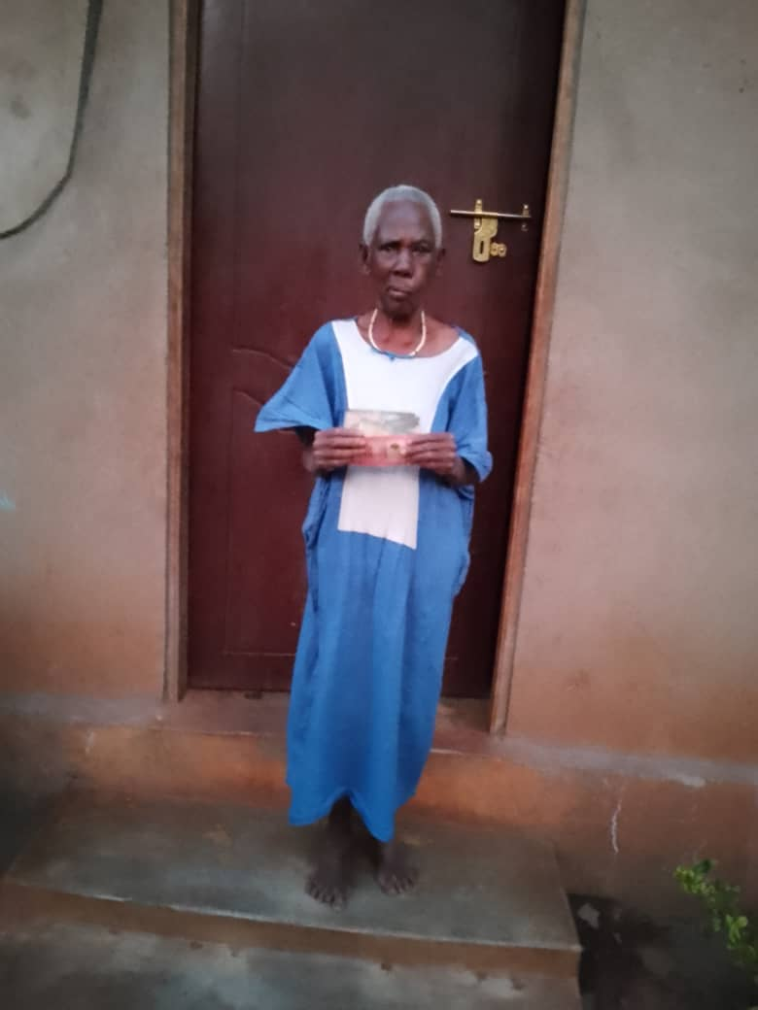
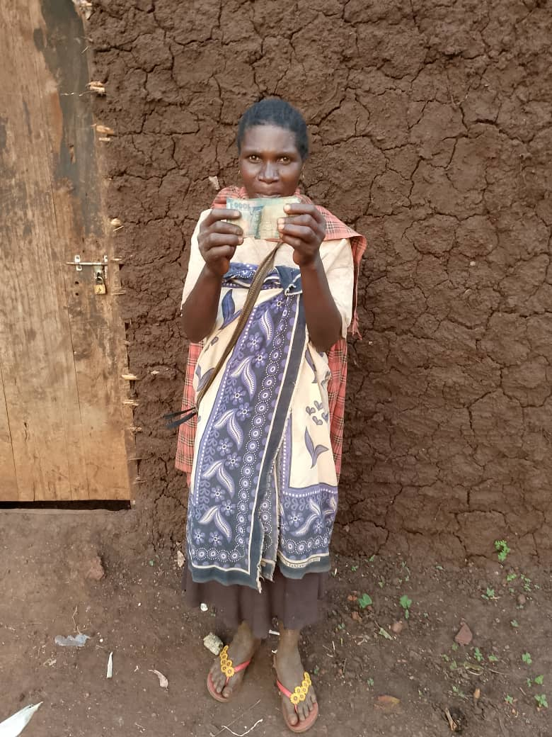
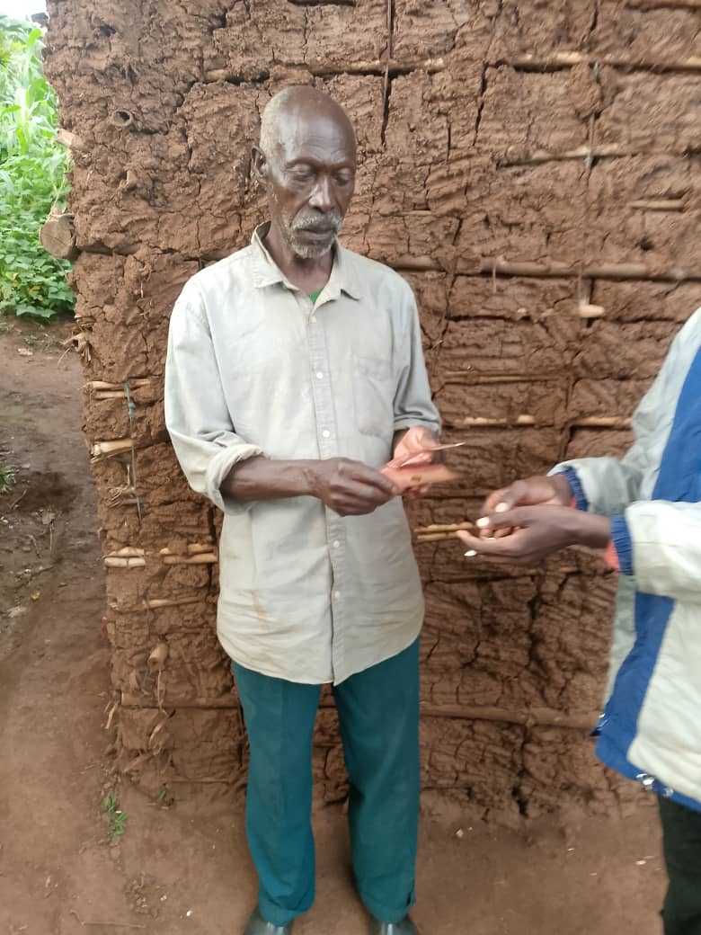
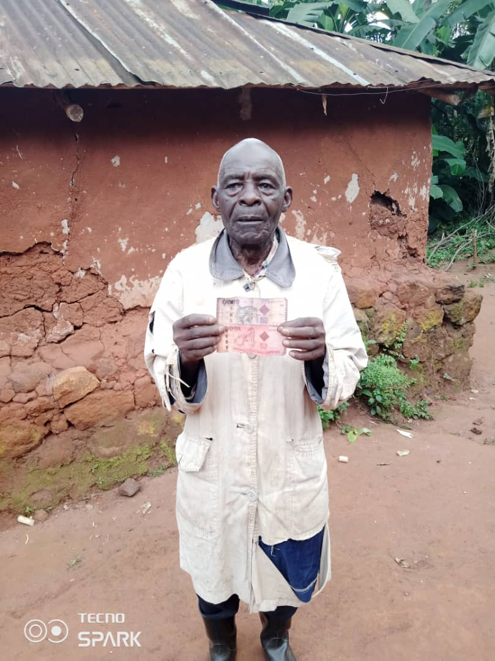
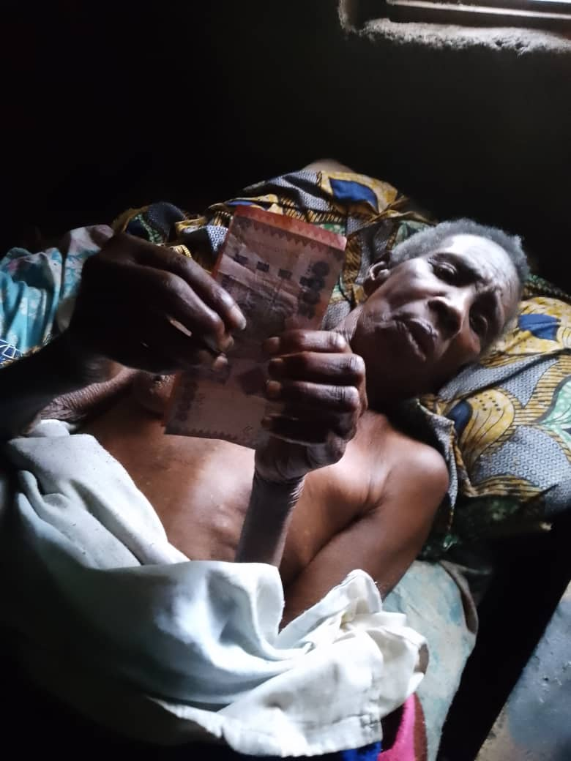
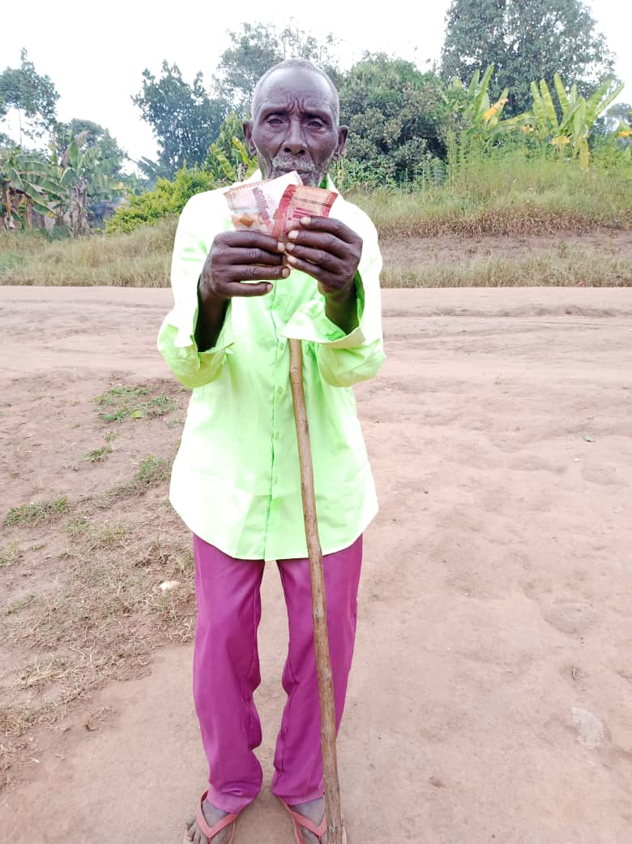
POOR PEOPLE SUPPORT
951 West Side Avenue,
JERSEY CITY, NJ- 07306
East Africa
May 2025

Slide 8
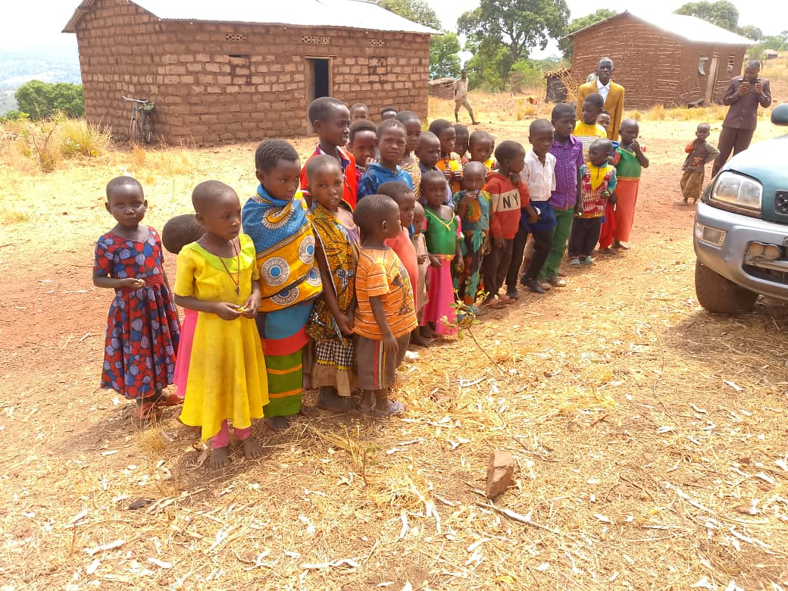
SUNDAY SCHOOL
951 West Side Avenue,
JERSEY CITY, NJ- 07306
East Africa
May 2025

Slide 9

Spiritual Growth & Revival – Pray for spiritual revival in the churches of Rwanda and Tanzania, that believers may grow in faith and impact their communities.
Church Ministry & Outreach – Pray for the continued success of evangelism efforts, outreach ministries, and the expansion of God’s kingdom in these mission fields.
New Believers & Baptisms – Pray for the individuals who have been baptized, that they remain strong in their faith and become active in their churches.
Mission Fields – Pray for the mission fields where pastors and church leaders are ministering, that they may bear fruit and bring more souls to Christ.
Strength for Pastors – Pray for the 43 pastors who are working in these areas, that they remain encouraged and steadfast in their ministry.
New Churcg – Pray for established new churches, and their other needs.
Pastor Support – Pray for consistent monthly support ($30-$40 per pastor) so that they can continue ministering effectively.
People Support – Pray for provisions to help the needy, with at least $10 per month per person to sustain basic necessities for struggling families.
Provision for Ministry Resources – Pray for continued funding to supply Bibles, training materials, and other resources needed for effective evangelism.
951 West Side Avenue,
JERSEY CITY, NJ- 07306
East Africa
May 2025

Slide 10
Spiritual Growth & Revival – Pray for spiritual revival in the churches of Rwanda and Tanzania, that believers may grow in faith and impact their communities.
Church Ministry & Outreach – Pray for the continued success of evangelism efforts, outreach ministries, and the expansion of God’s kingdom in these mission fields.
New Believers & Baptisms – Pray for the individuals who have been baptized, that they remain strong in their faith and become active in their churches.
Mission Fields – Pray for the mission fields where pastors and church leaders are ministering, that they may bear fruit and bring more souls to Christ.
Strength for Pastors – Pray for the 43 pastors who are working in these areas, that they remain encouraged and steadfast in their ministry.
951 West Side Avenue,
JERSEY CITY, NJ- 07306
East Africa
May 2025

Slide 11
New Churcg – Pray for established new churches, and their other needs.
Pastor Support – Pray for consistent monthly support ($30-$40 per pastor) so that they can continue ministering effectively.
People Support – Pray for provisions to help the needy, with at least $10 per month per person to sustain basic necessities for struggling families.
Provision for Ministry Resources – Pray for continued funding to supply Bibles, training materials, and other resources needed for effective evangelism.
951 West Side Avenue,
JERSEY CITY, NJ- 07306
East Africa
May 2025

