Slide 1



Mission Report
1. Number of Pastors - 19
2. Churches and Mission Field - 19
3. New Member added - 16
4. House Prayer - 119
5. Fasting Prayer - 92
6. Night Prayer - 7
7. Outreach - 29
8. Youth Meeting - 54
9. Bible Distribution - 4
42
3
242
Sri Lanka
-
-
-
April 2025

Slide 2
Mission Report
10. Widow, disabled & blind support - 17
11. Church/School Construction - 1
12. Academic/English School - 8
13. Academic/English School Teachers - 11
14. Tamil/Bible School - 1
15. Tamil/Bible School Teacher - 1
16. Shelter Home - 1
42
3
242
Sri Lanka
-
-
-
April 2025

Slide 3
JFM Mission
Support for Churches and Pastors
Children & Youth Ministry
Academic and English Class
Tamil school, Bible College
Widows, Physically challenged, Elder Support, Shelter Home
Sri Lanka
April 2025

Slide 4
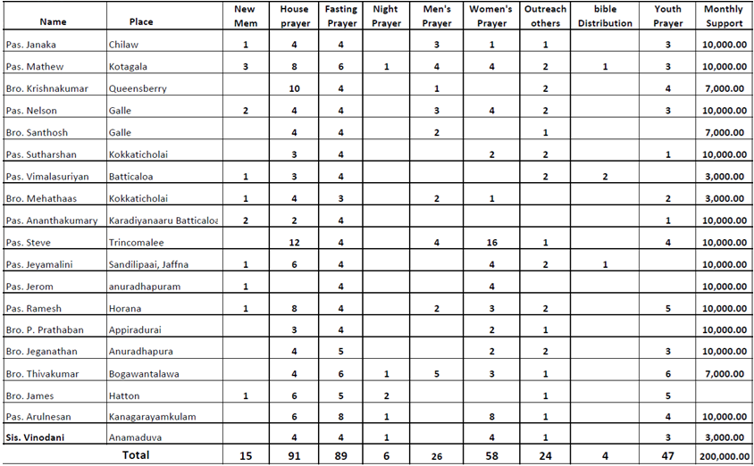
Mission Support
42
3
242
Sri Lanka
-
-
-
April 2025

Slide 5
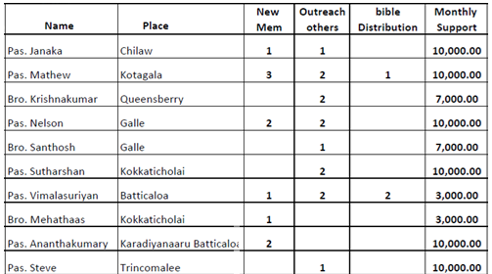
Mission Support
42
3
242
Sri Lanka
-
-
-
April 2025

Slide 6
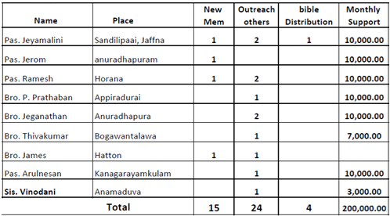
Mission Support
42
3
242
Sri Lanka
-
-
-
April 2025

Slide 7
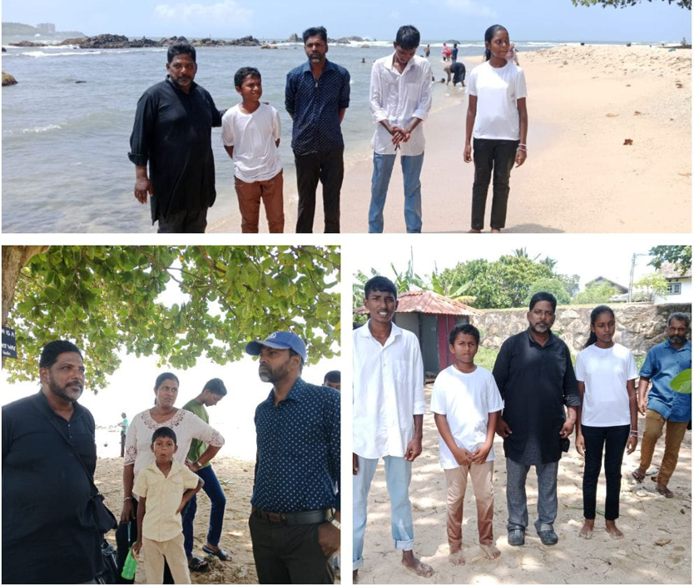
Baptism
Sri Lanka
April 2025

Slide 8
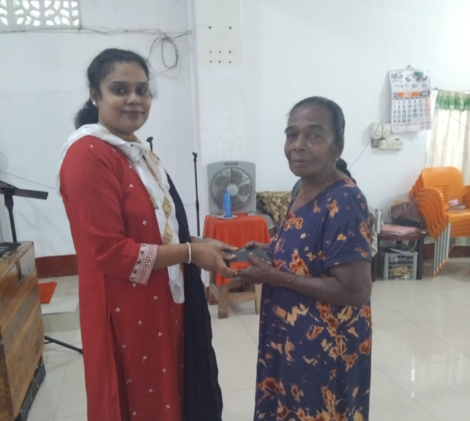
Bible Distribution
Sri Lanka
April 2025

Slide 9
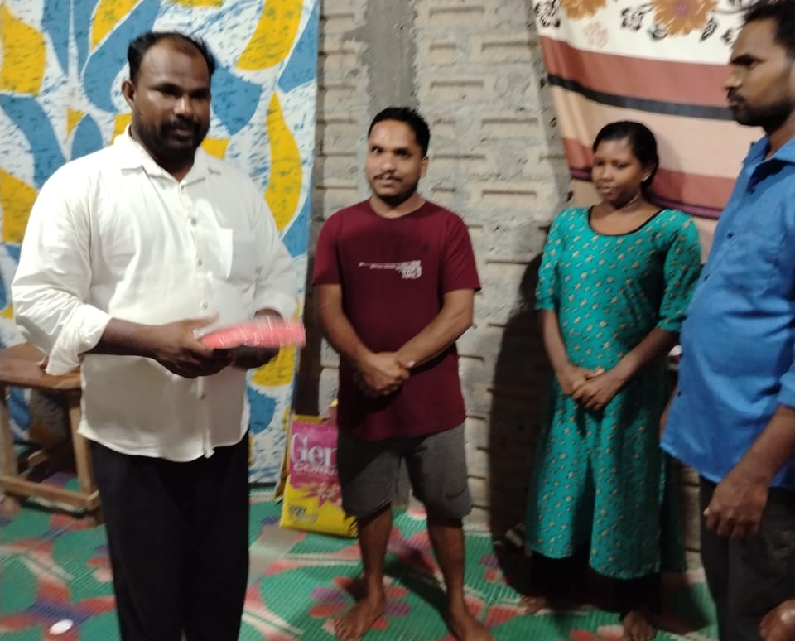
Bible Distribution
Sri Lanka
April 2025

Slide 10
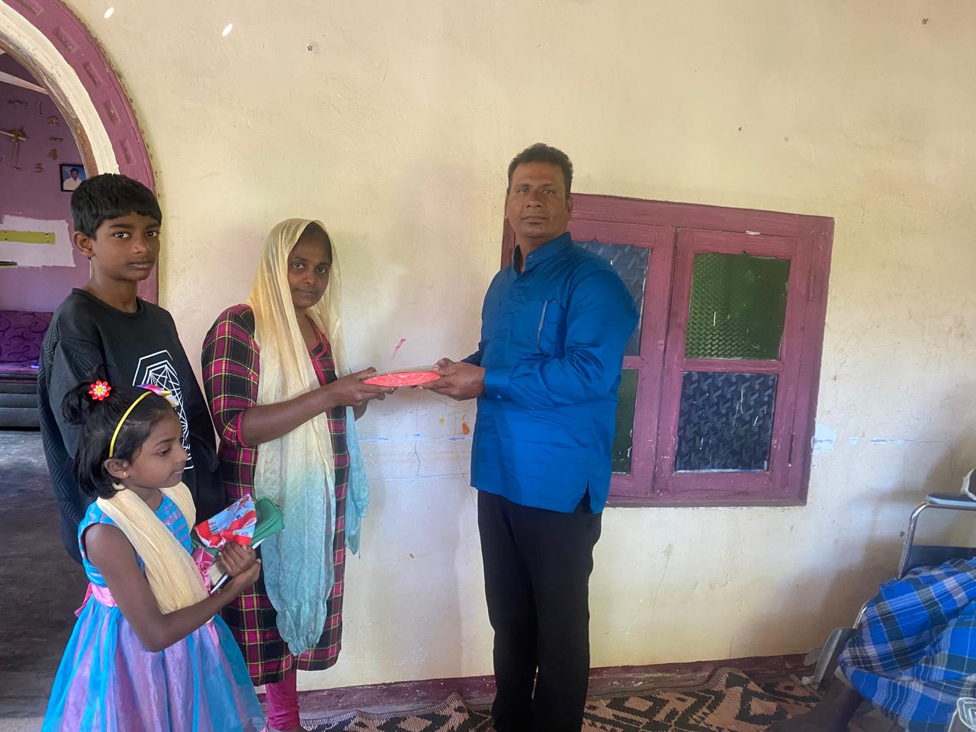
Bible Distribution
Sri Lanka
April 2025

Slide 11
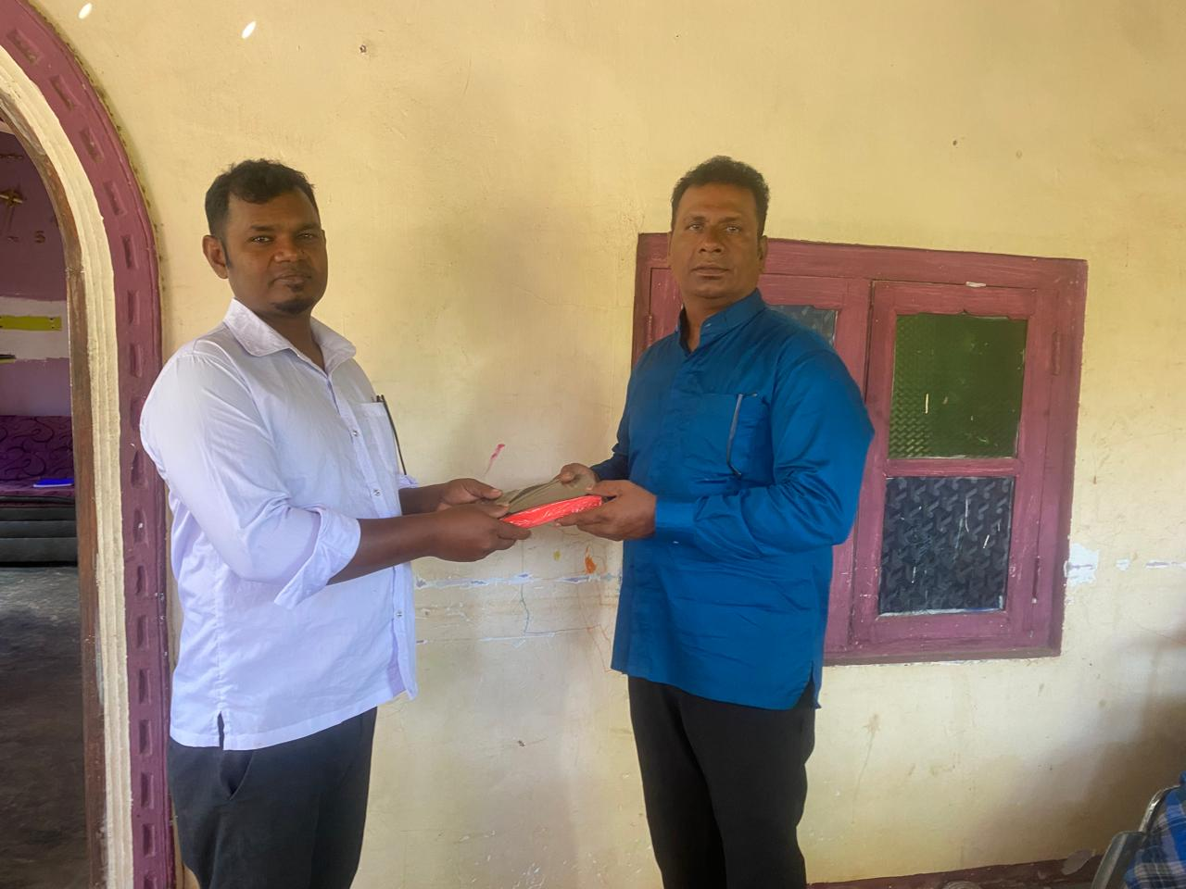
Bible Distribution
Sri Lanka
April 2025

Slide 12
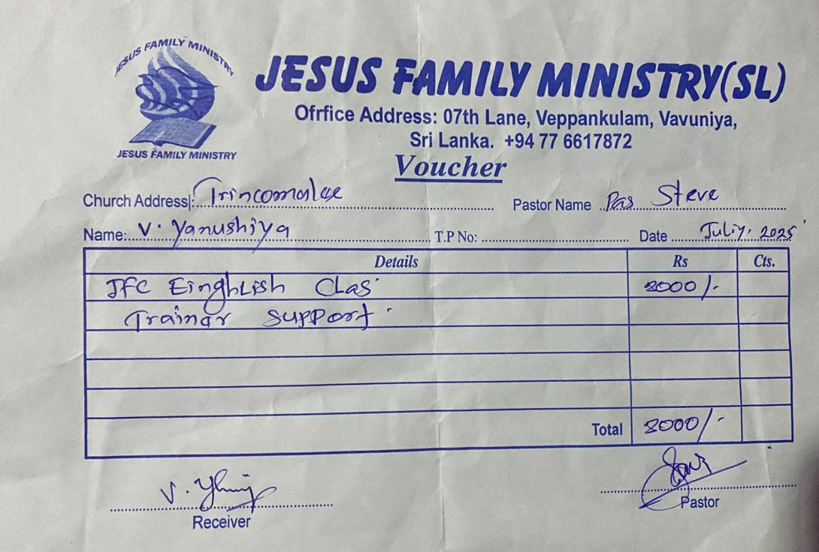
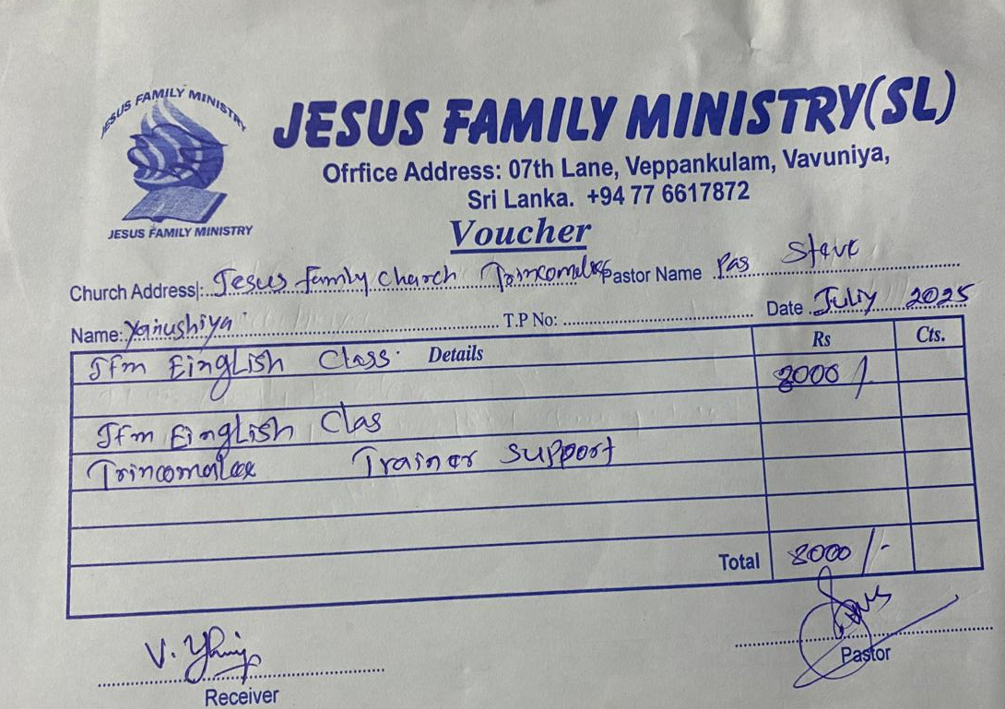
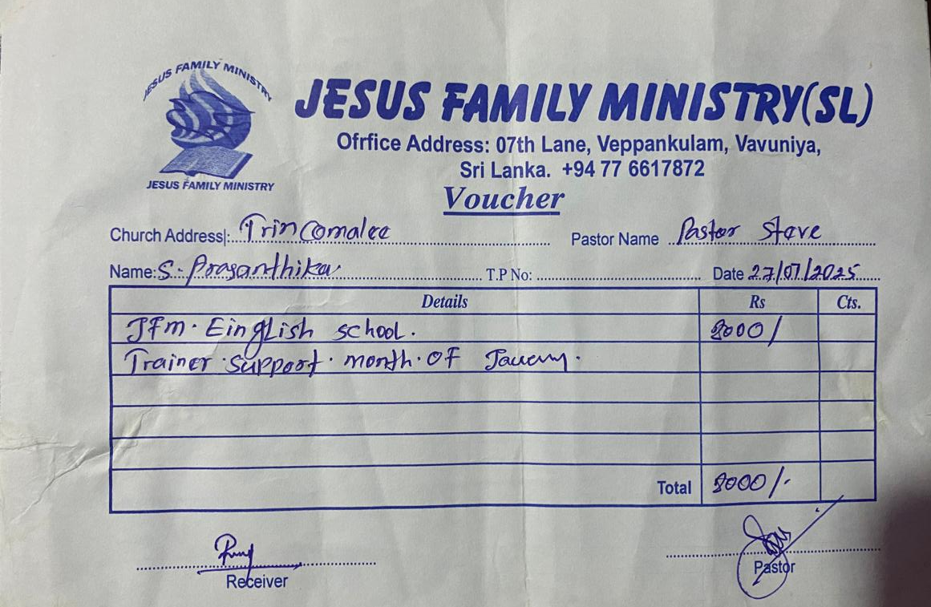
Education Support
Sri Lanka
April 2025

Slide 13
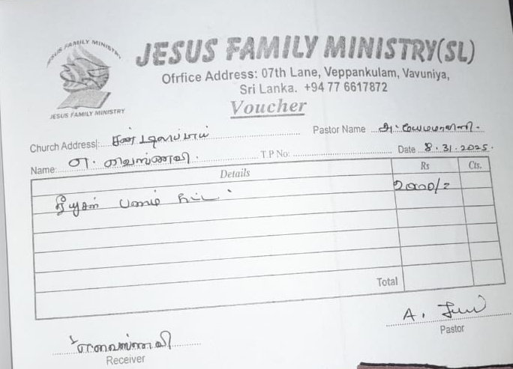
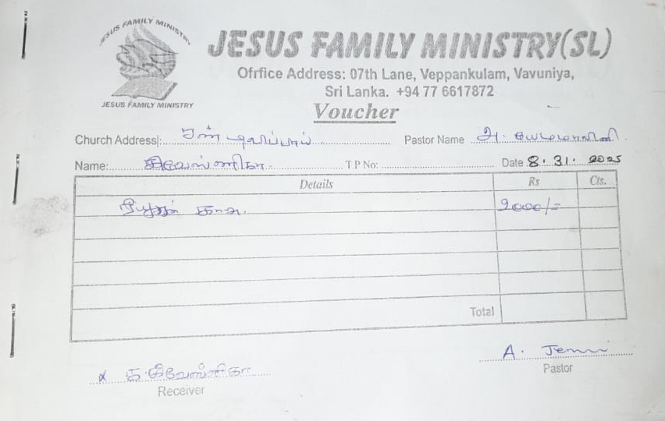
Education Support
Sri Lanka
April 2025

Slide 14
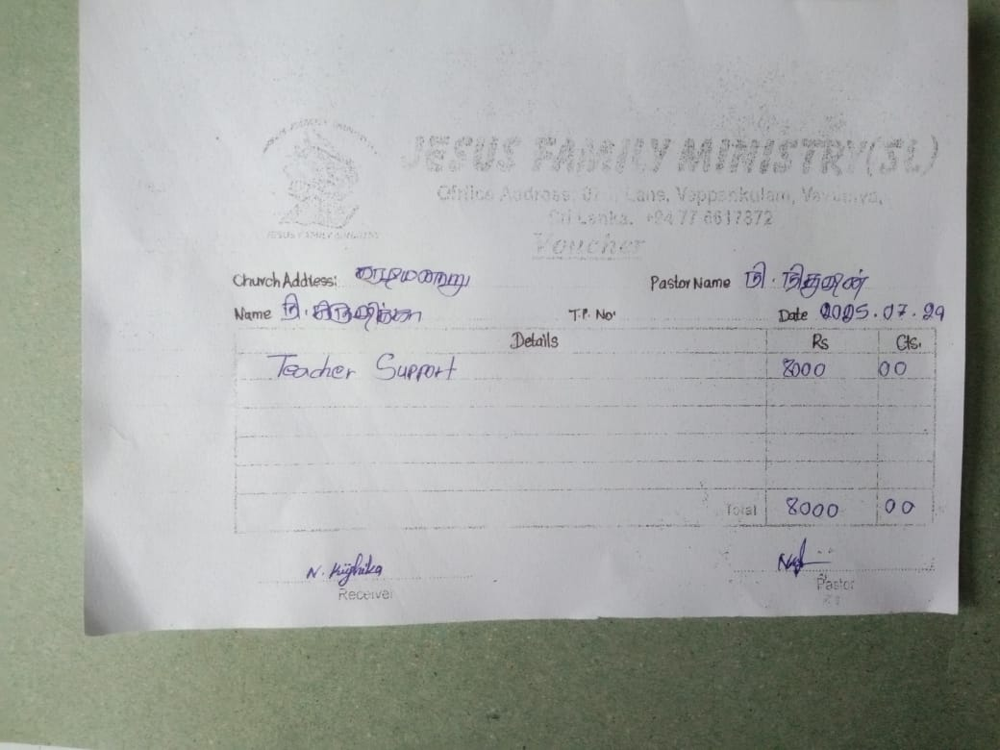
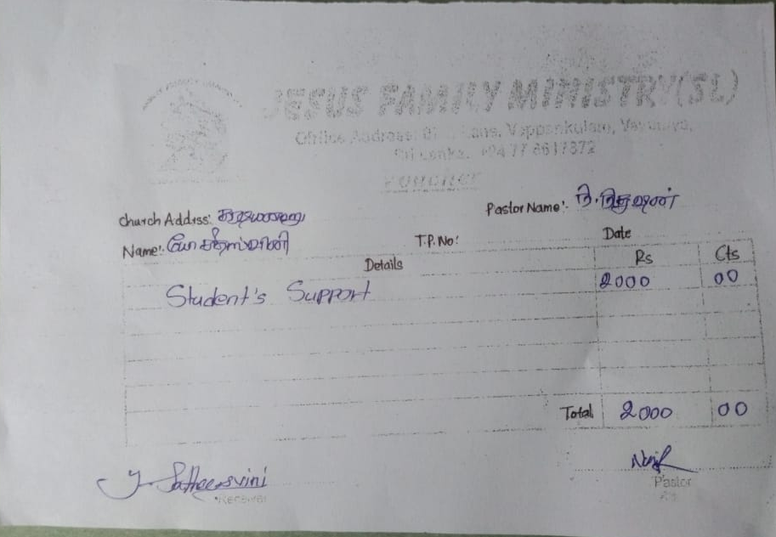
Education Support
Sri Lanka
April 2025

Slide 15
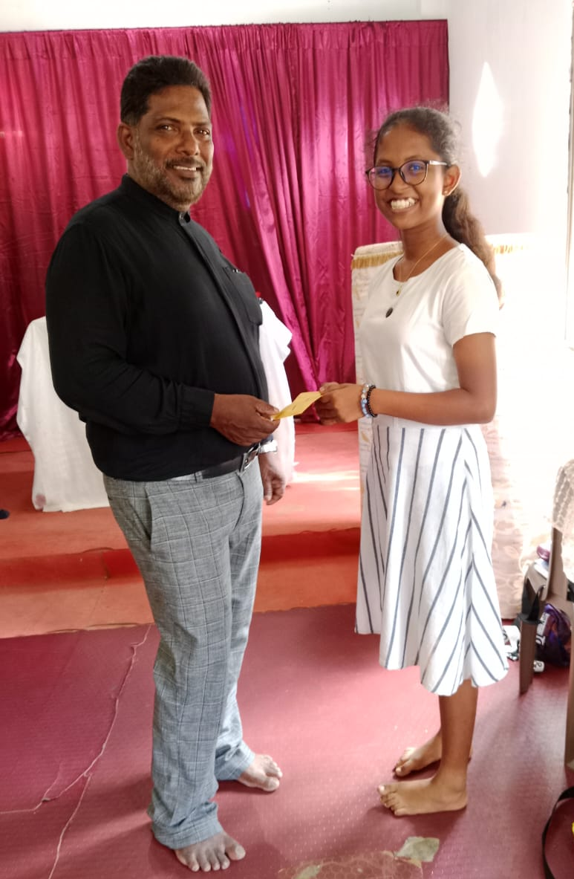
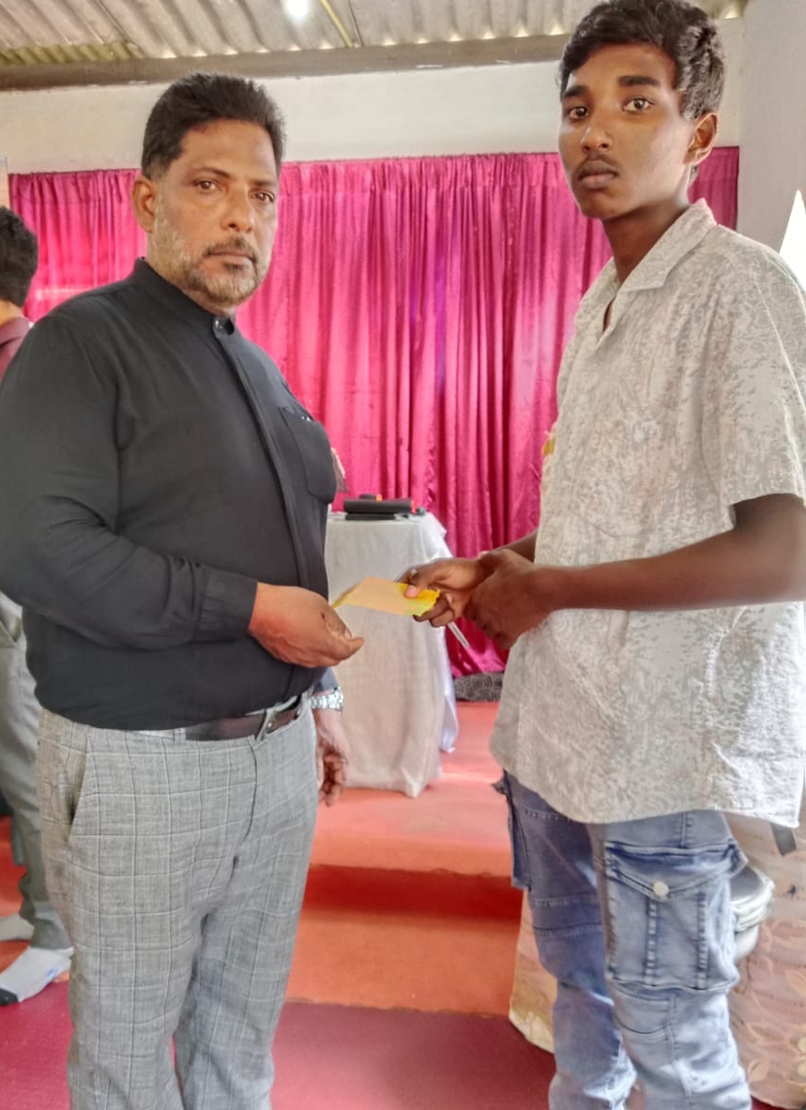
Education Support
Sri Lanka
April 2025

Slide 16
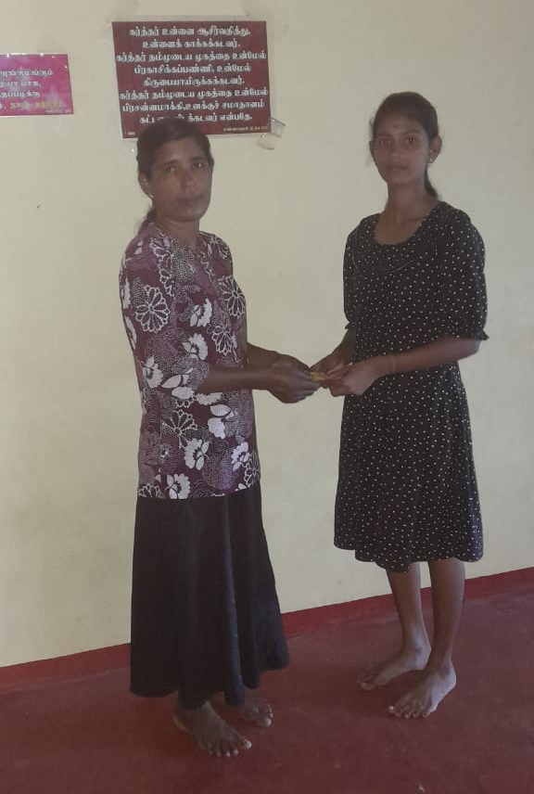
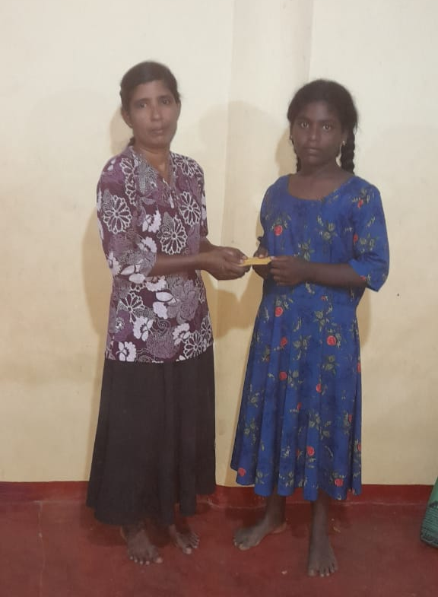
Education Support
Sri Lanka
April 2025

Slide 17
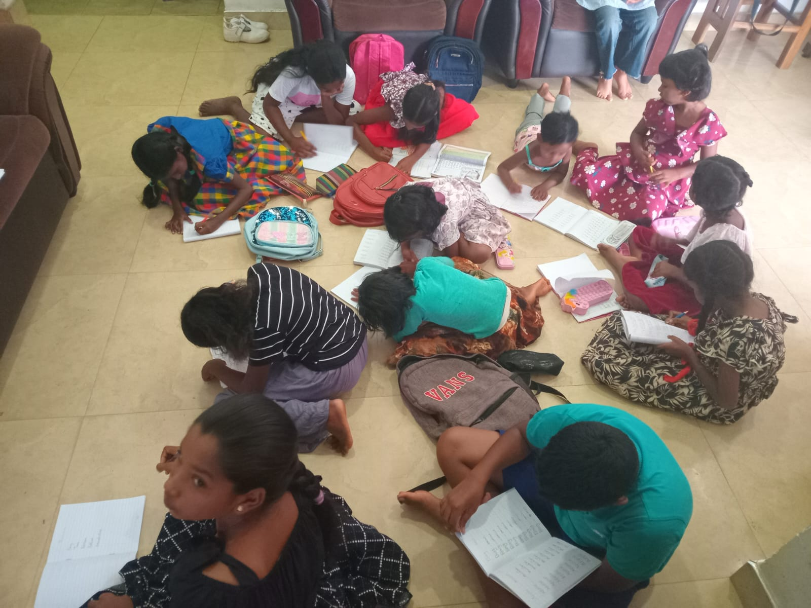
English School
Sri Lanka
April 2025

Slide 18
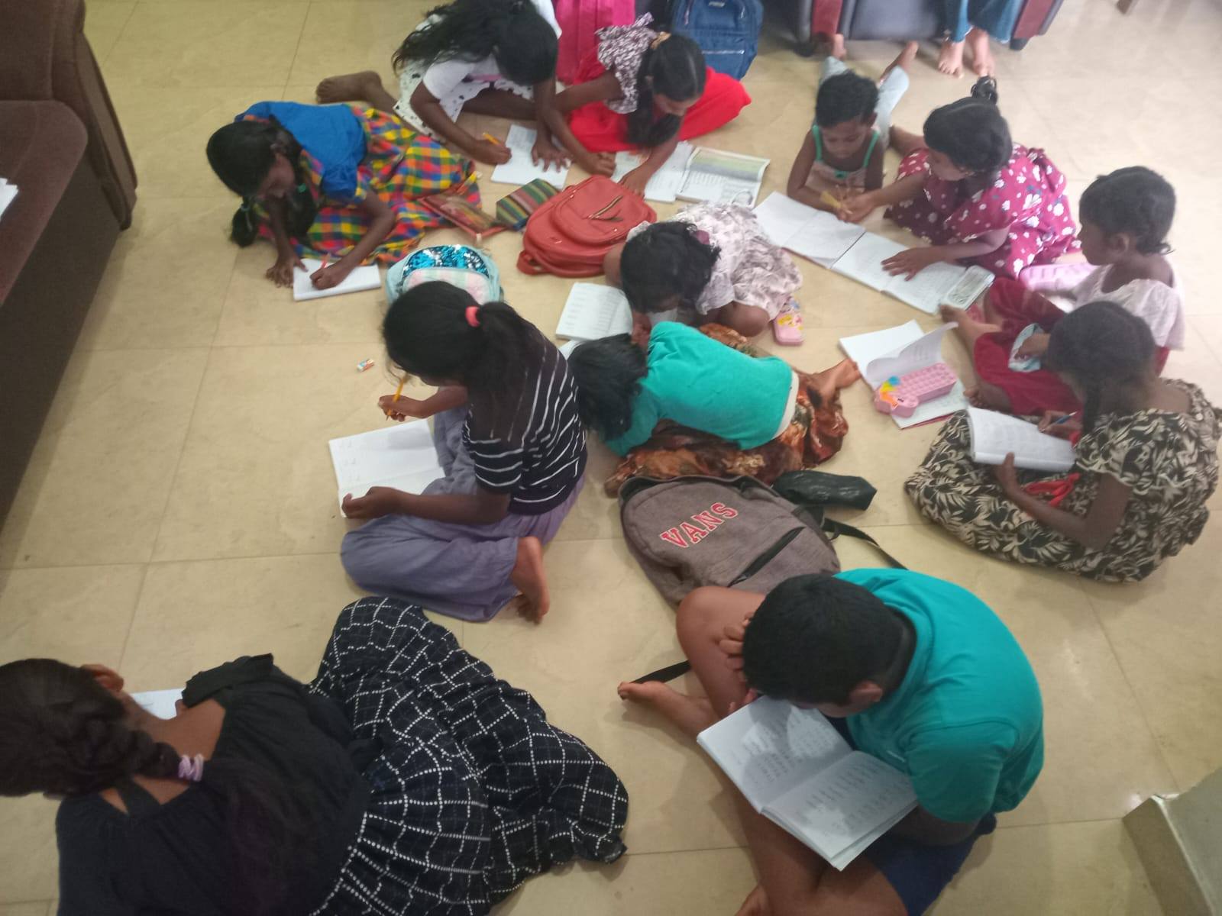
English School
Sri Lanka
April 2025

Slide 19
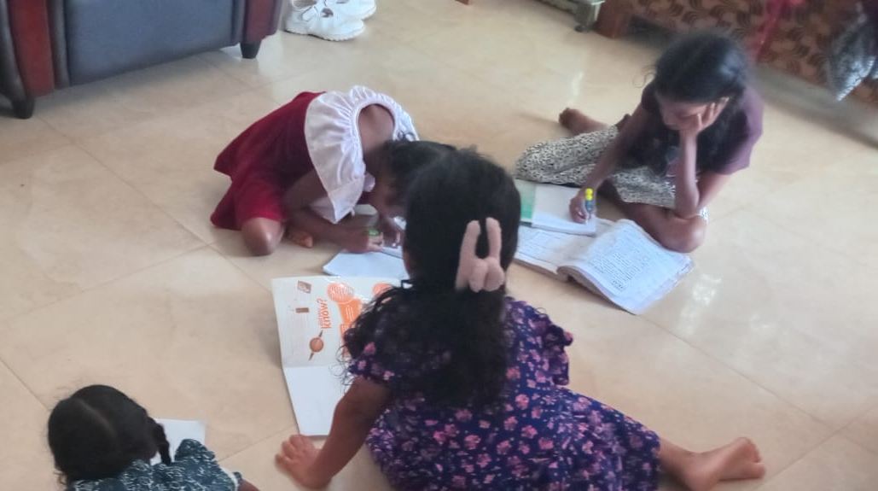
English School
Sri Lanka
April 2025

Slide 20
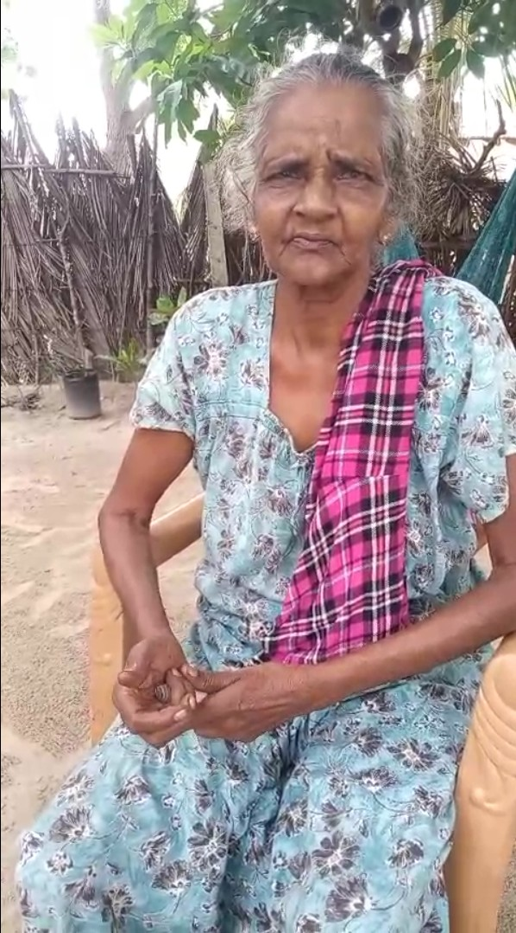
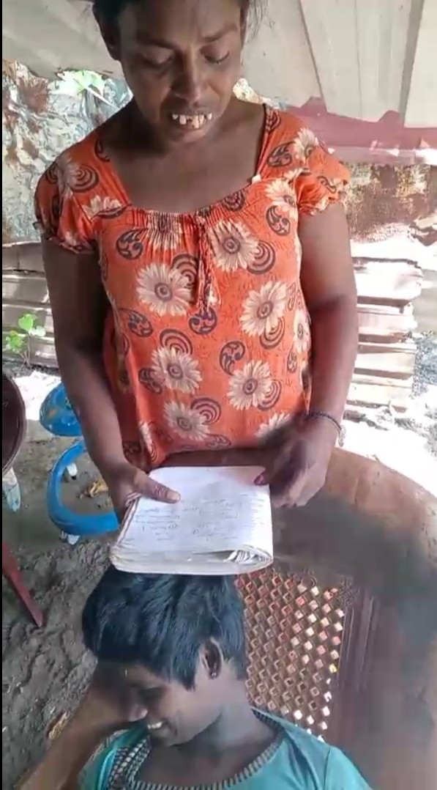
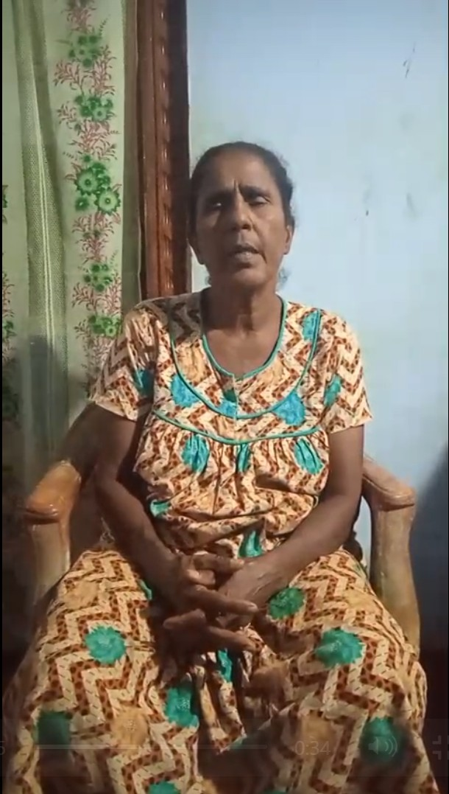
Social Support
Sri Lanka
April 2025

Slide 21
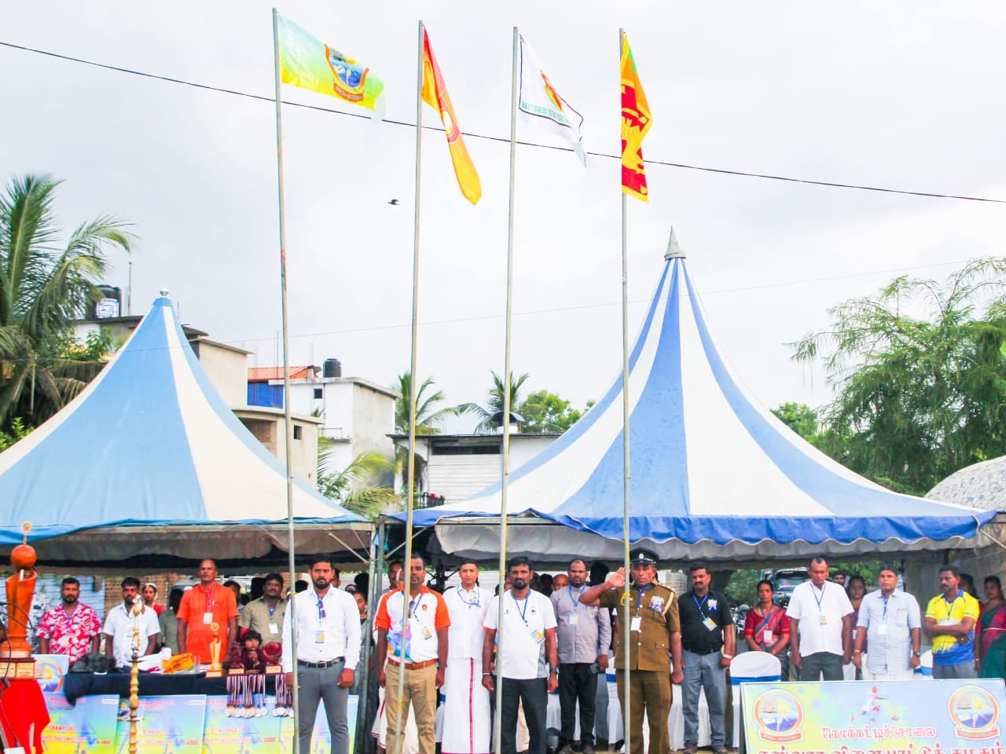
Community Engagement
Sri Lanka
April 2025

Slide 22
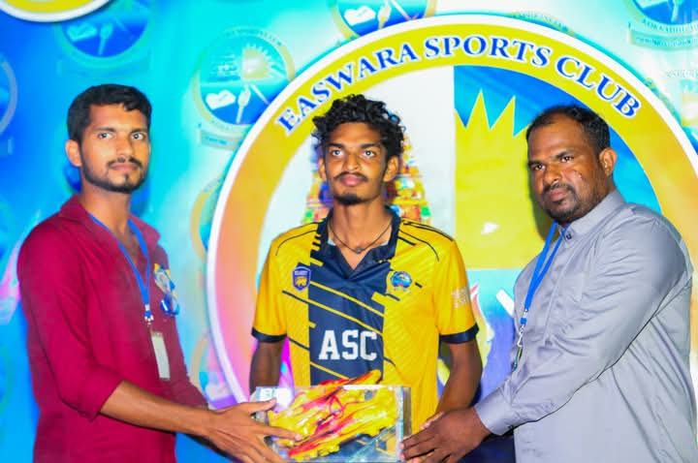
Community Engagement
Sri Lanka
April 2025

Slide 23
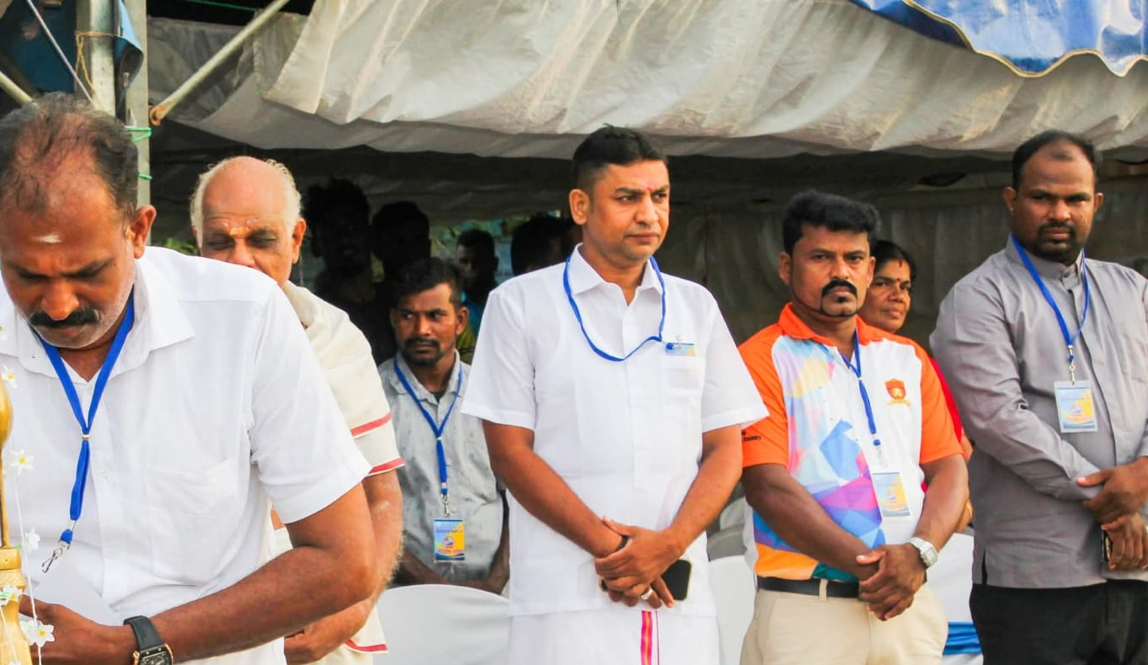
Community Engagement
Sri Lanka
April 2025

Slide 24
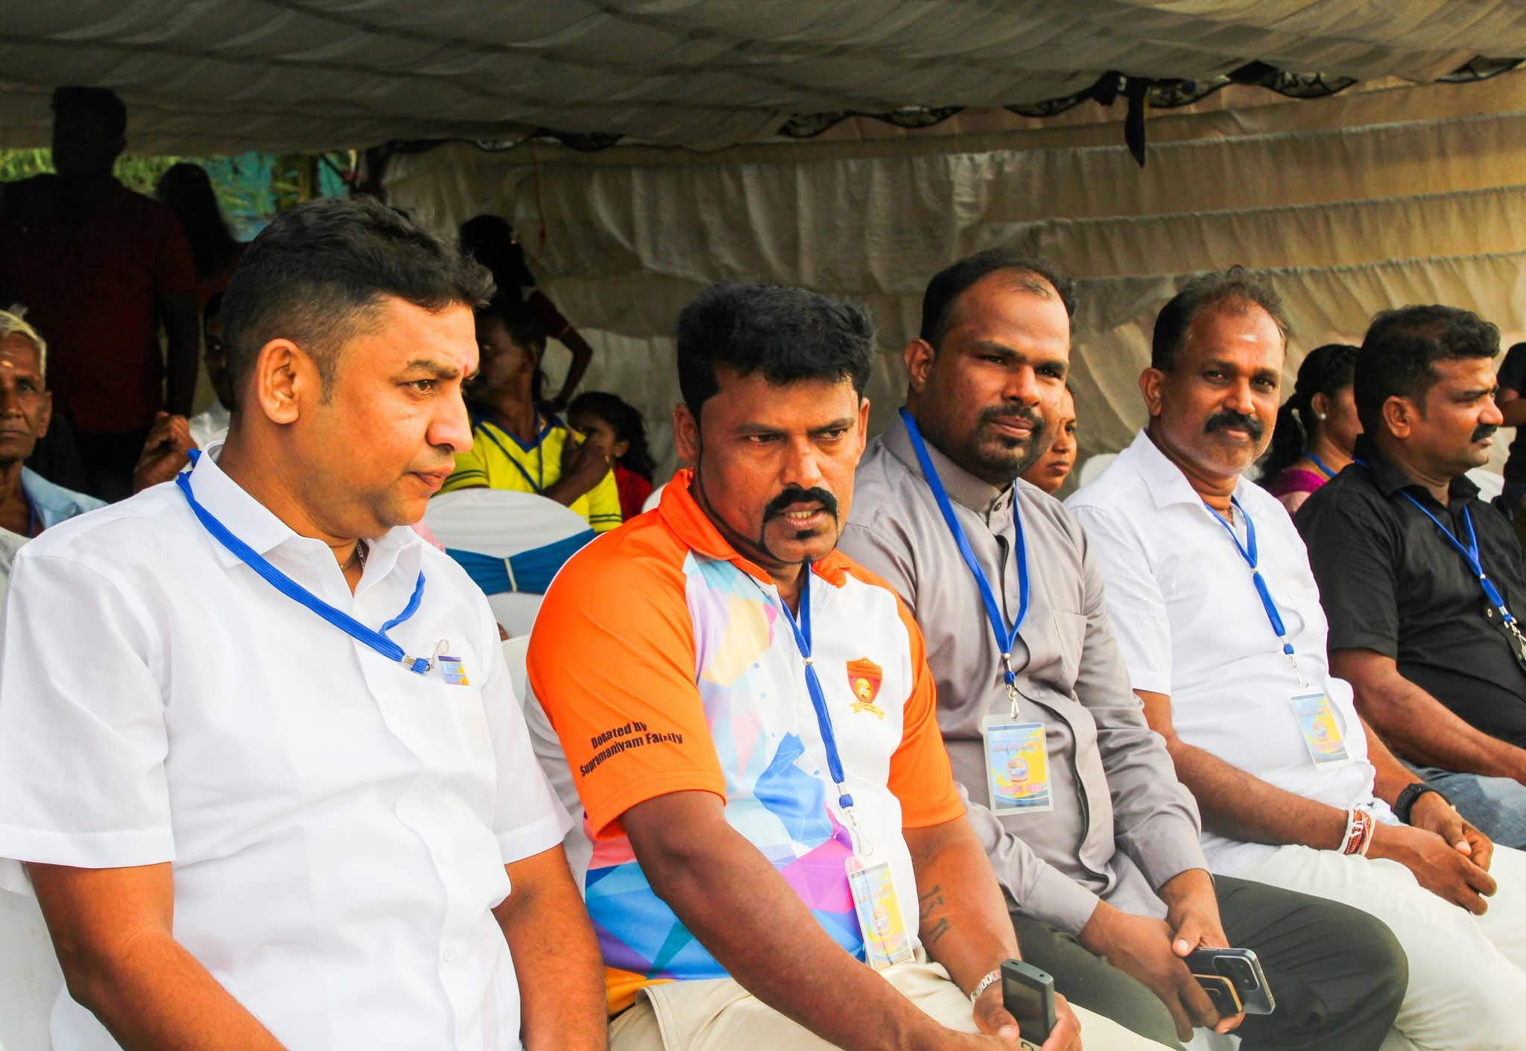
Community Engagement
Sri Lanka
April 2025

Slide 25
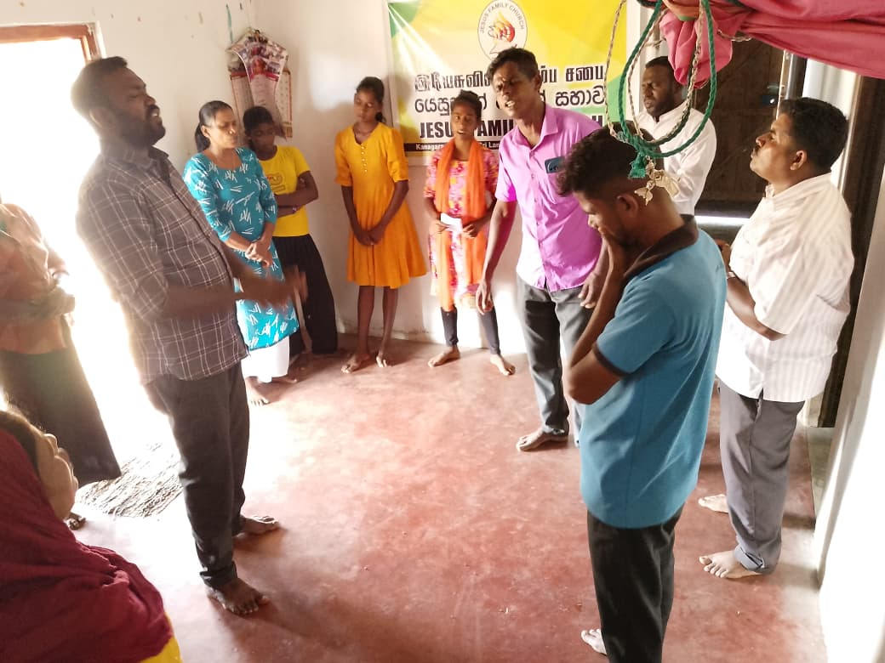
Outreach Ministries
Sri Lanka
April 2025

Slide 26
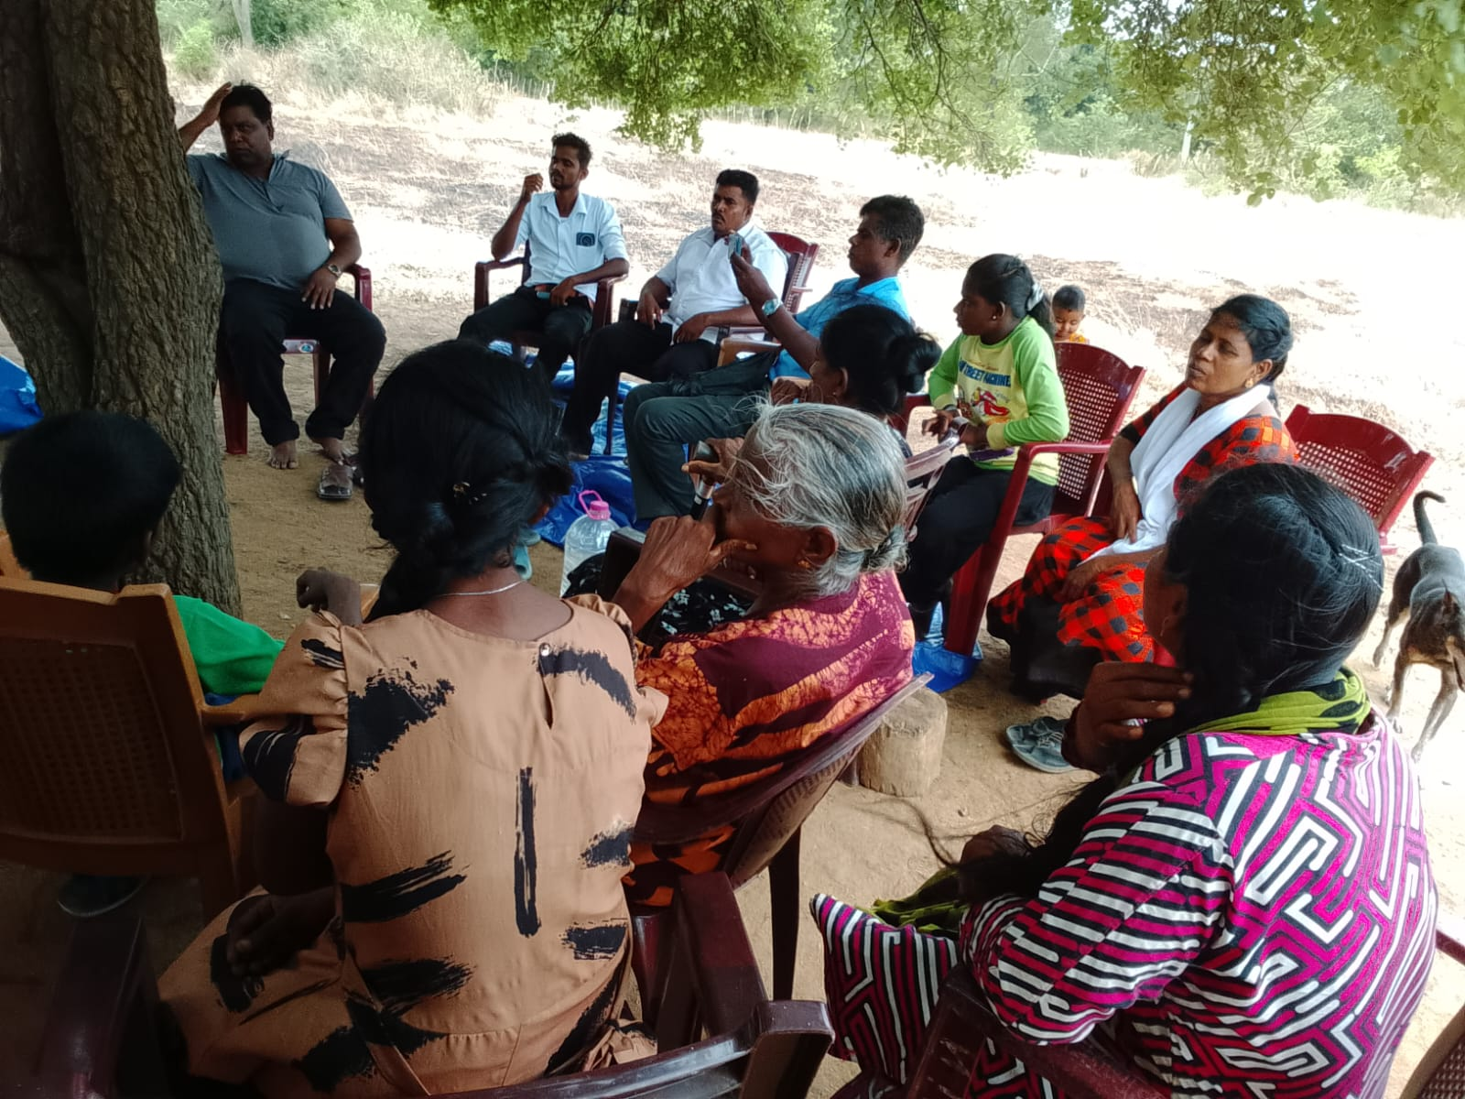
Outreach Ministries
Sri Lanka
April 2025

Slide 27
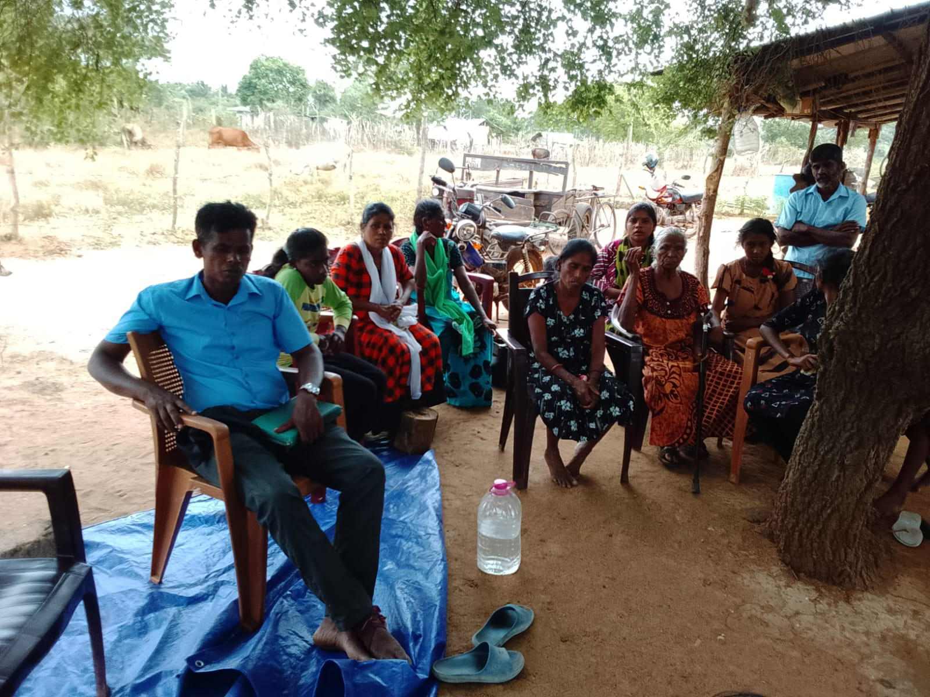
Outreach Ministries
Sri Lanka
April 2025

Slide 28
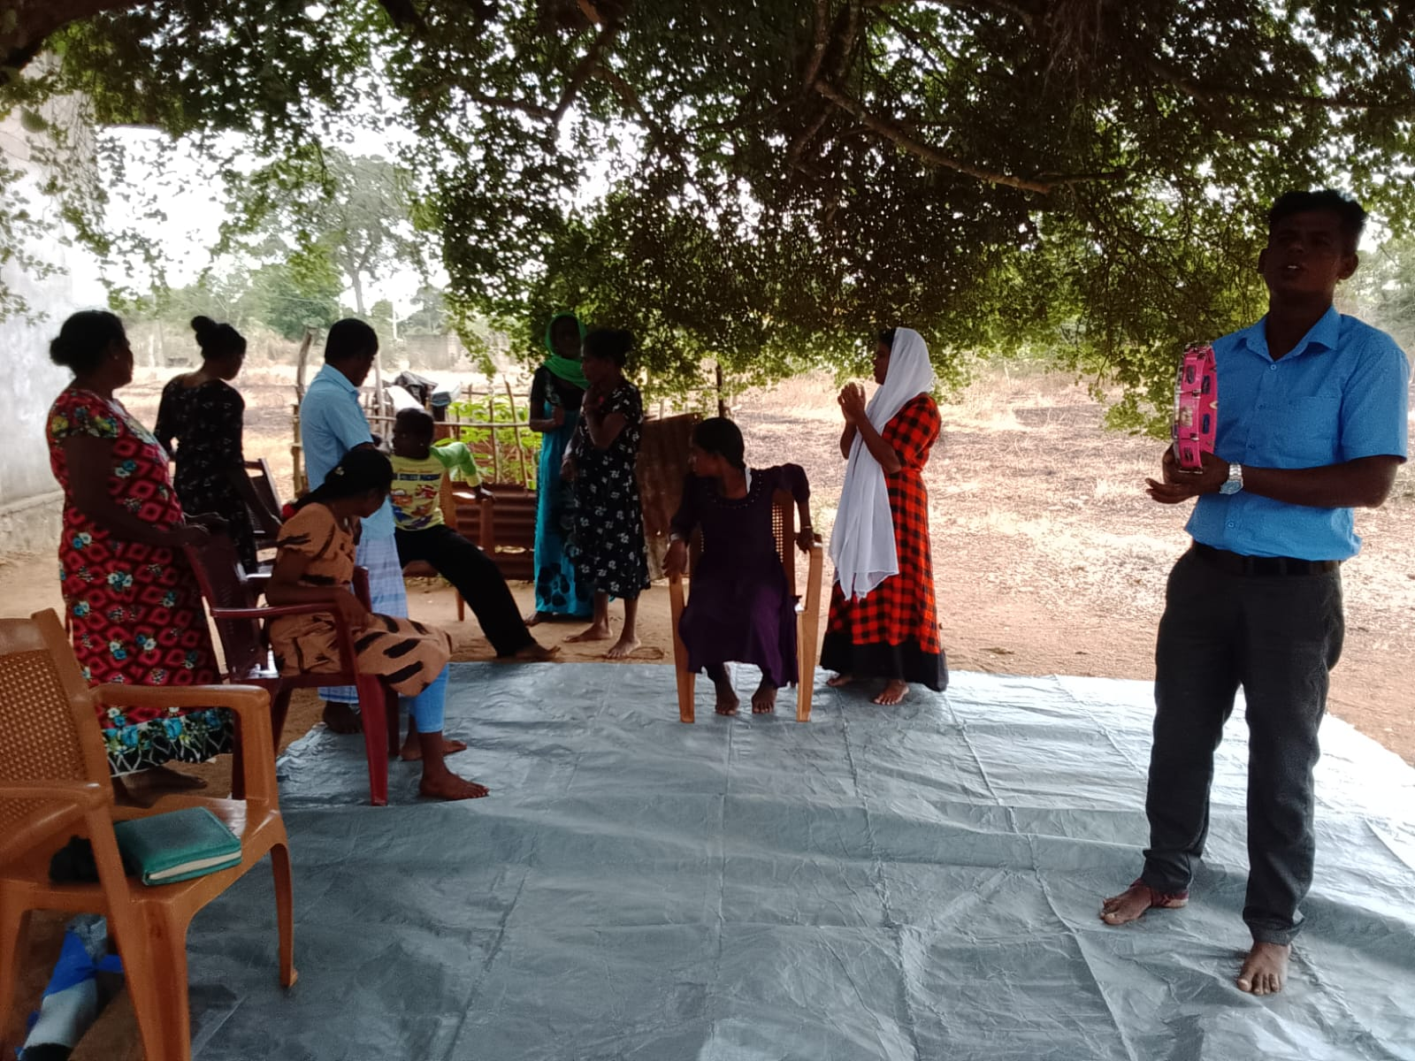
Outreach Ministries
Sri Lanka
April 2025

Slide 29
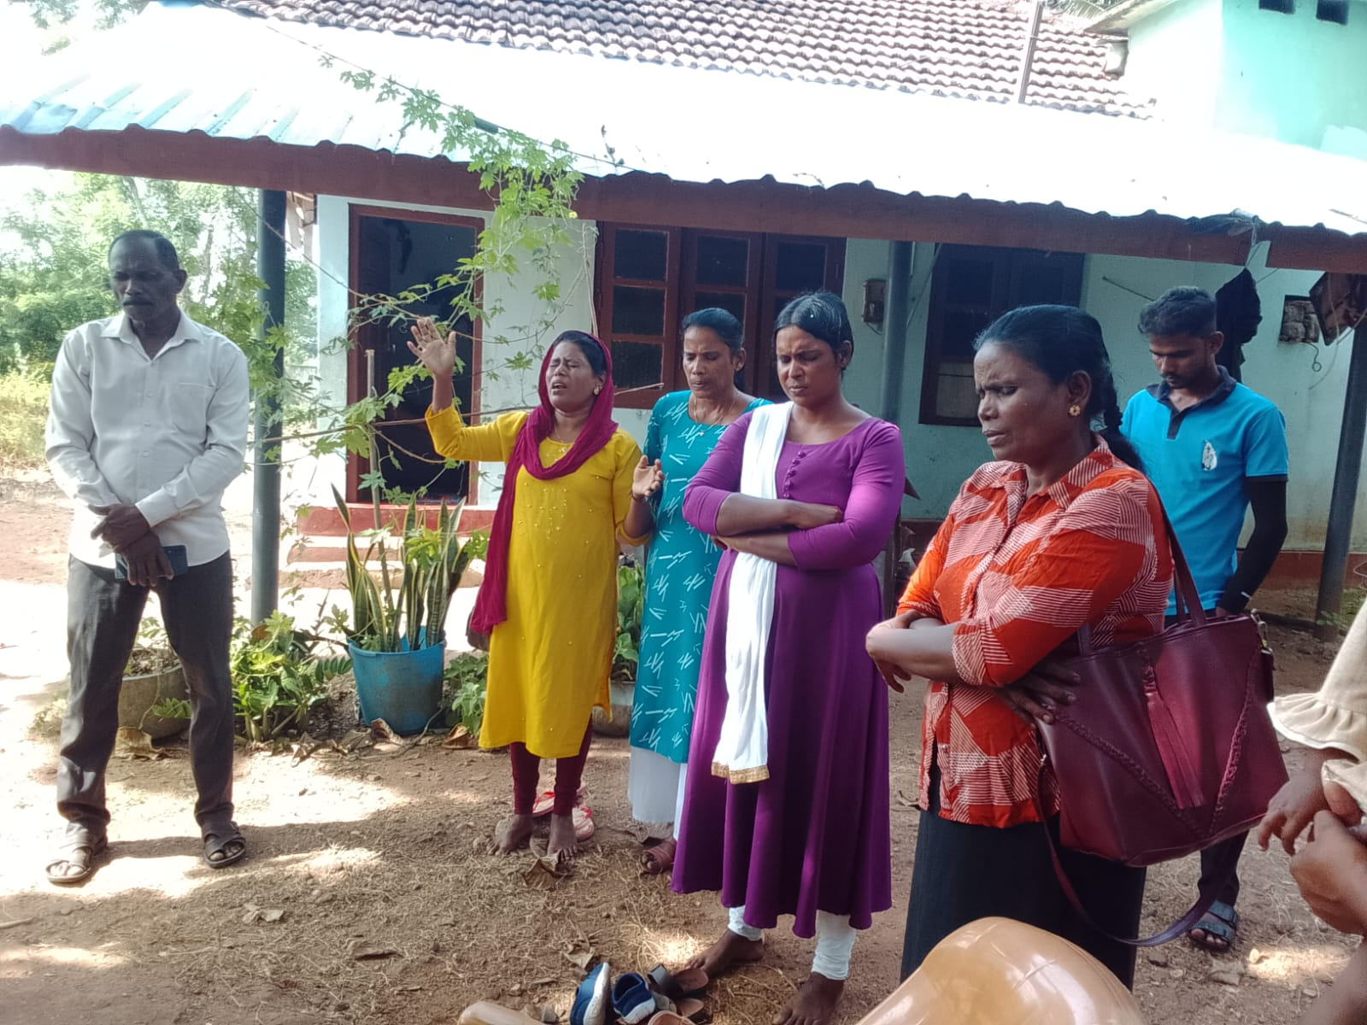
Outreach Ministries
Sri Lanka
April 2025

Slide 30
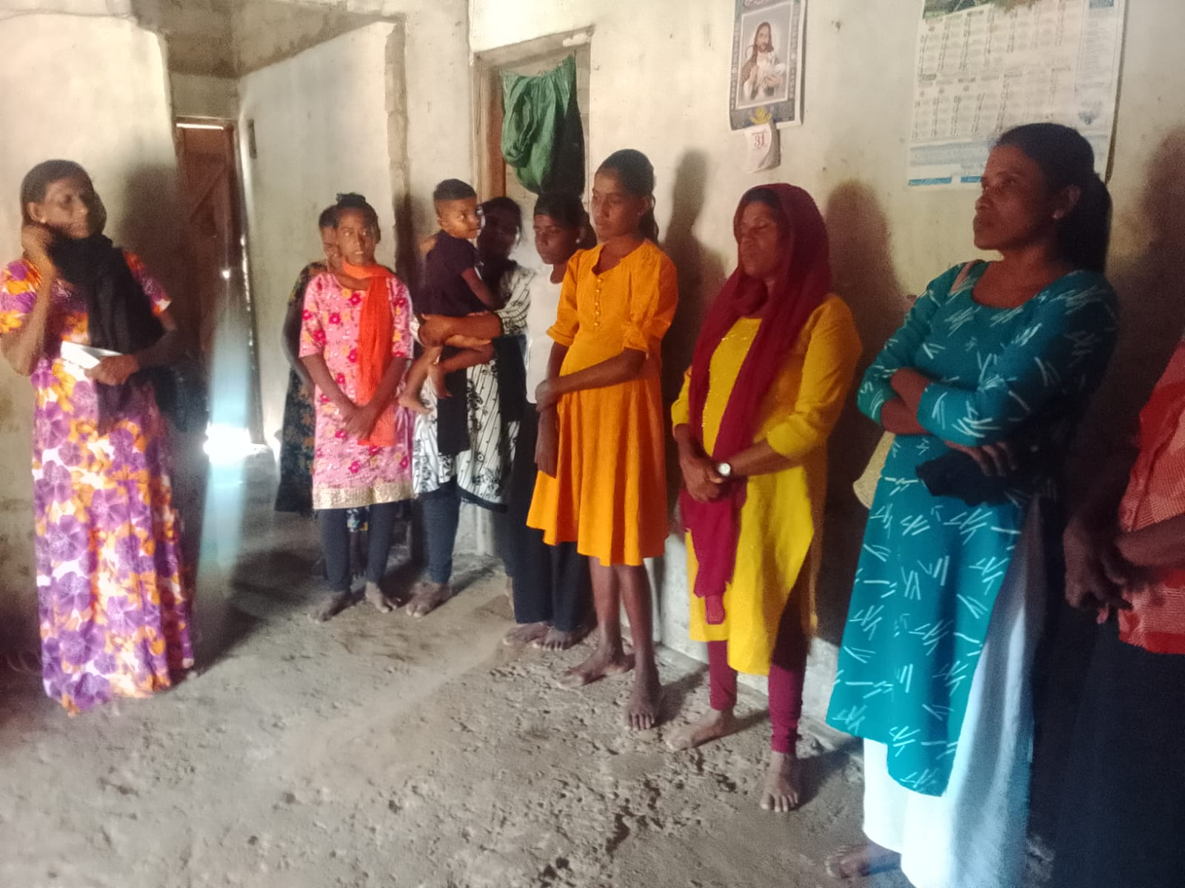
Outreach Ministries
Sri Lanka
April 2025

Slide 31
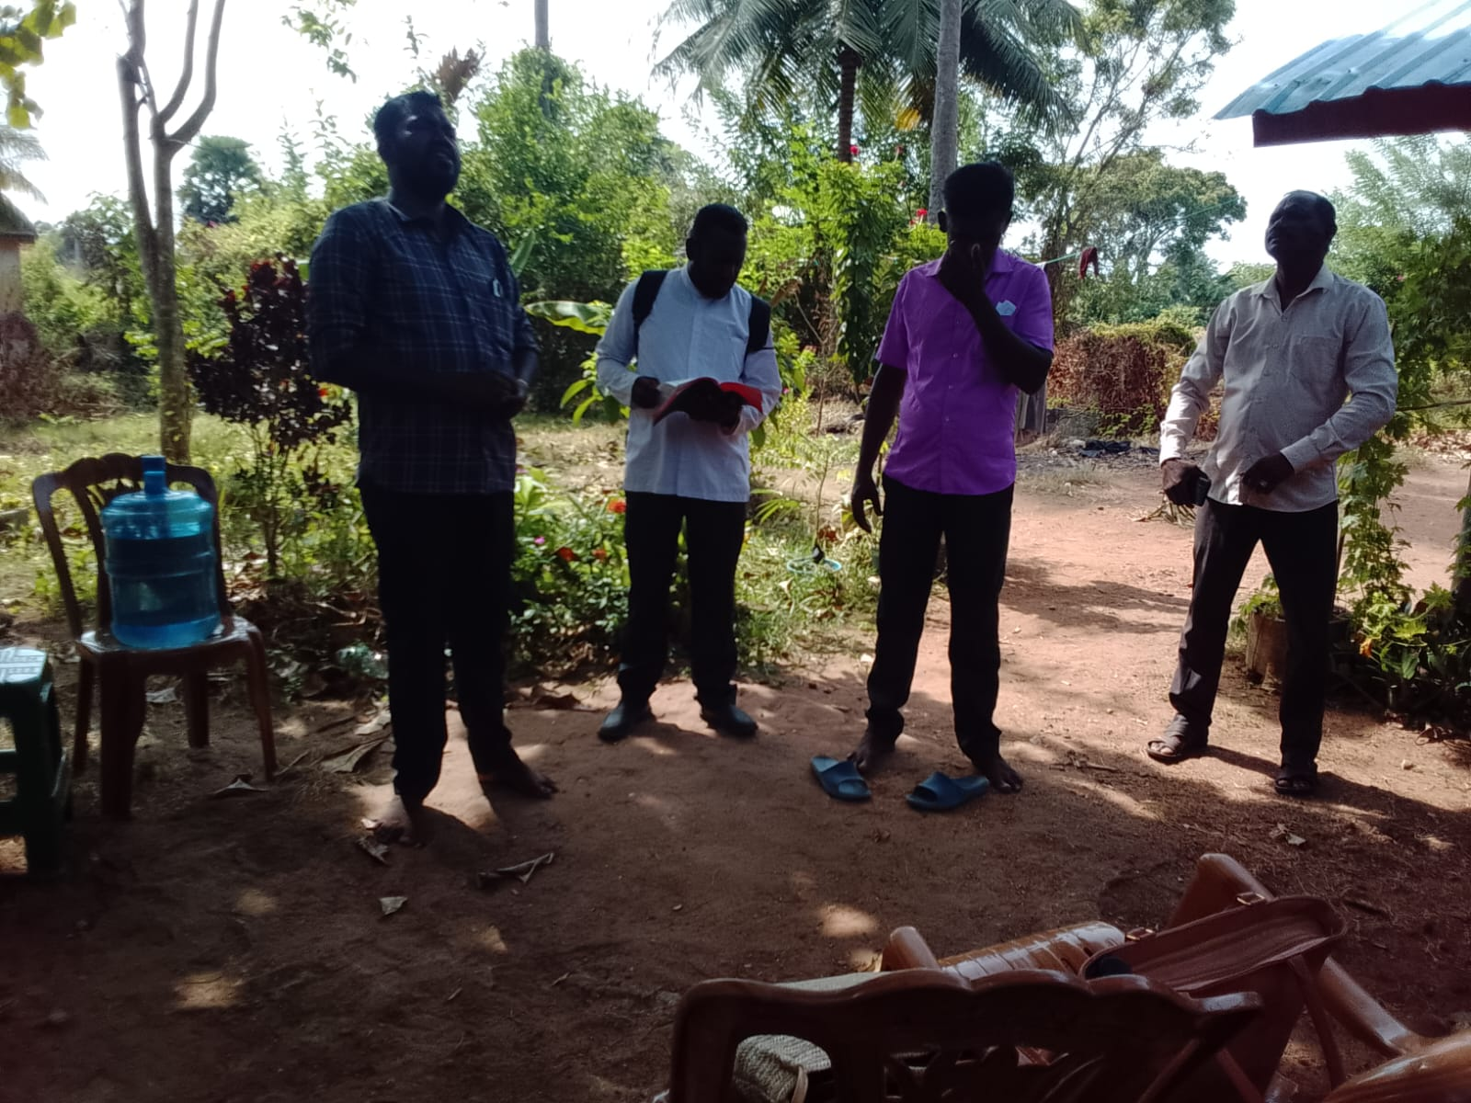
Outreach Ministries
Sri Lanka
April 2025

Slide 32
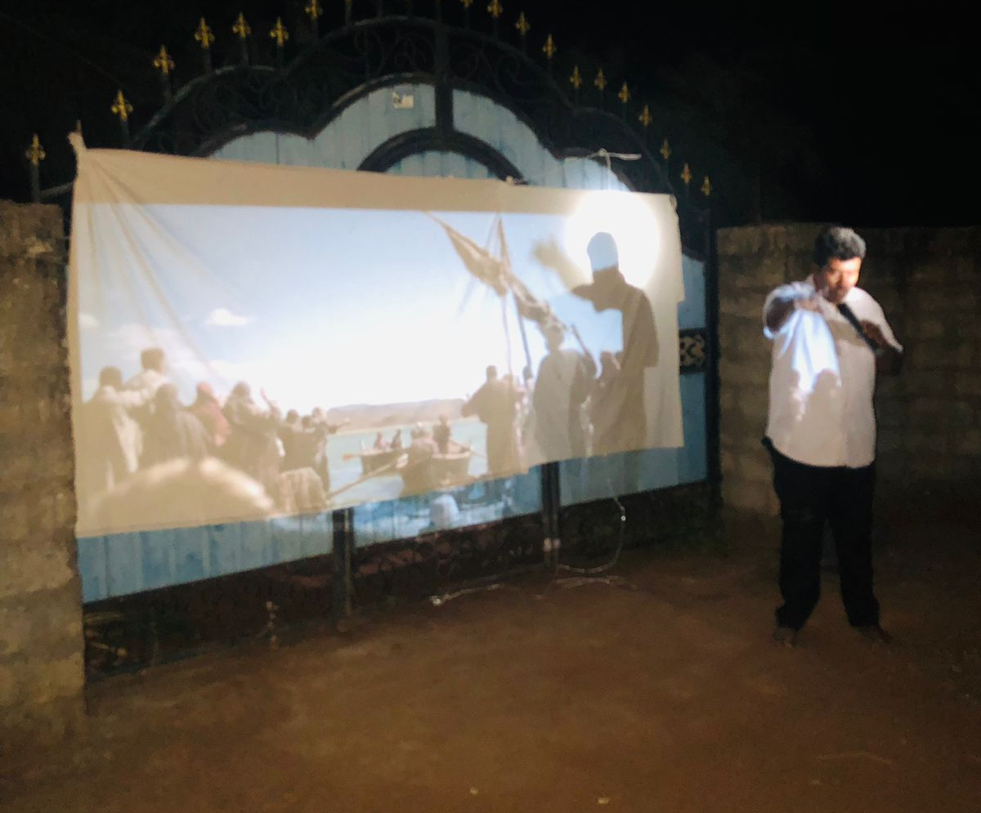
Outreach Ministries
Sri Lanka
April 2025

Slide 33
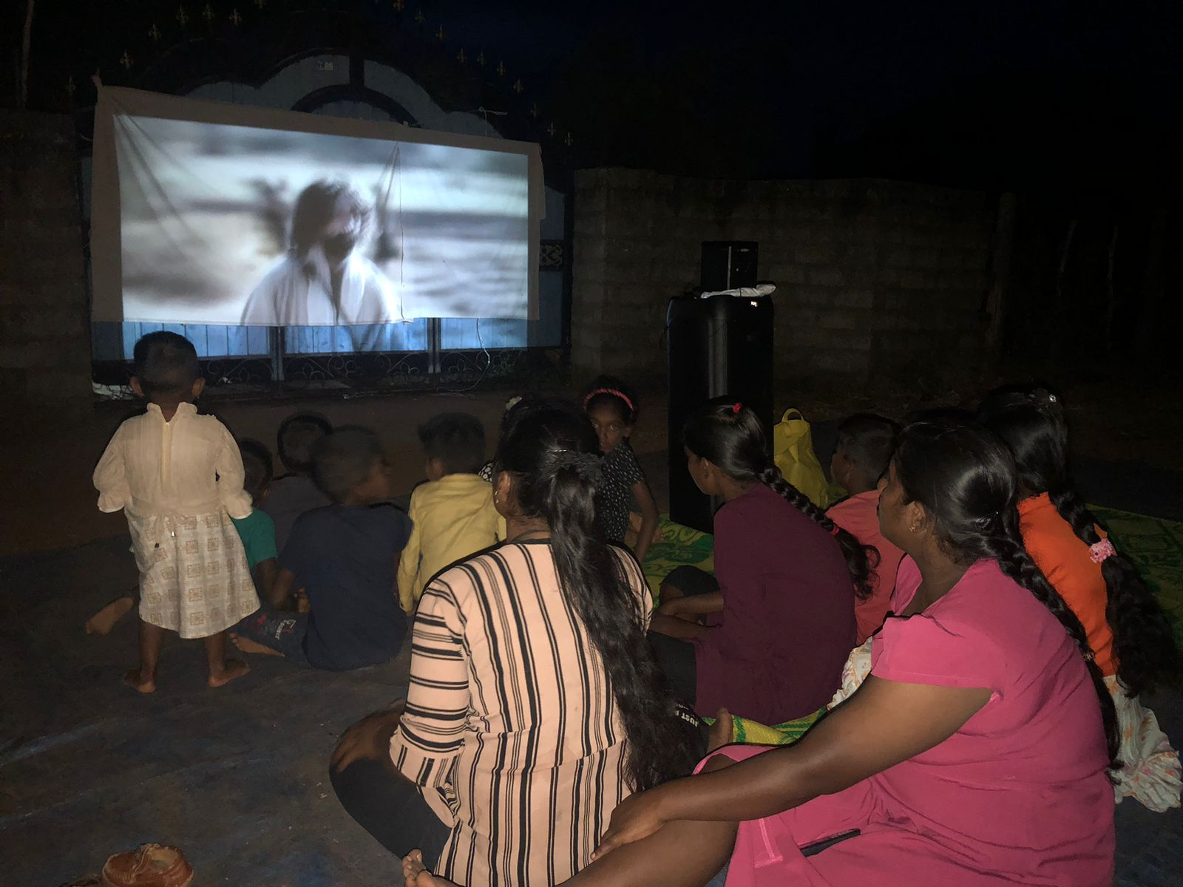
Outreach Ministries
Sri Lanka
April 2025

Slide 34
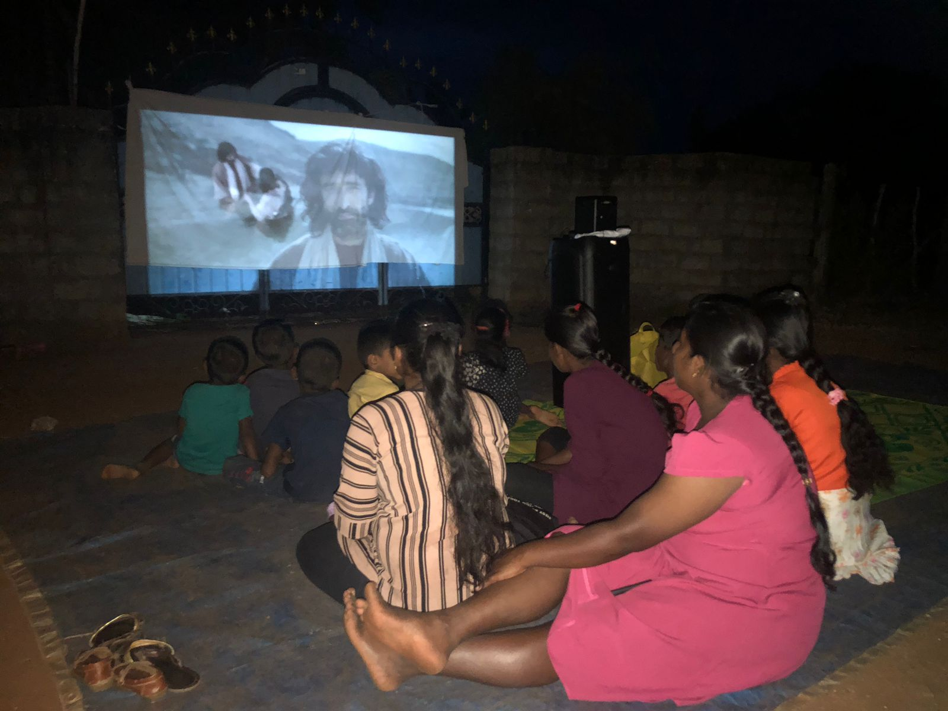
Outreach Ministries
Sri Lanka
April 2025

Slide 35
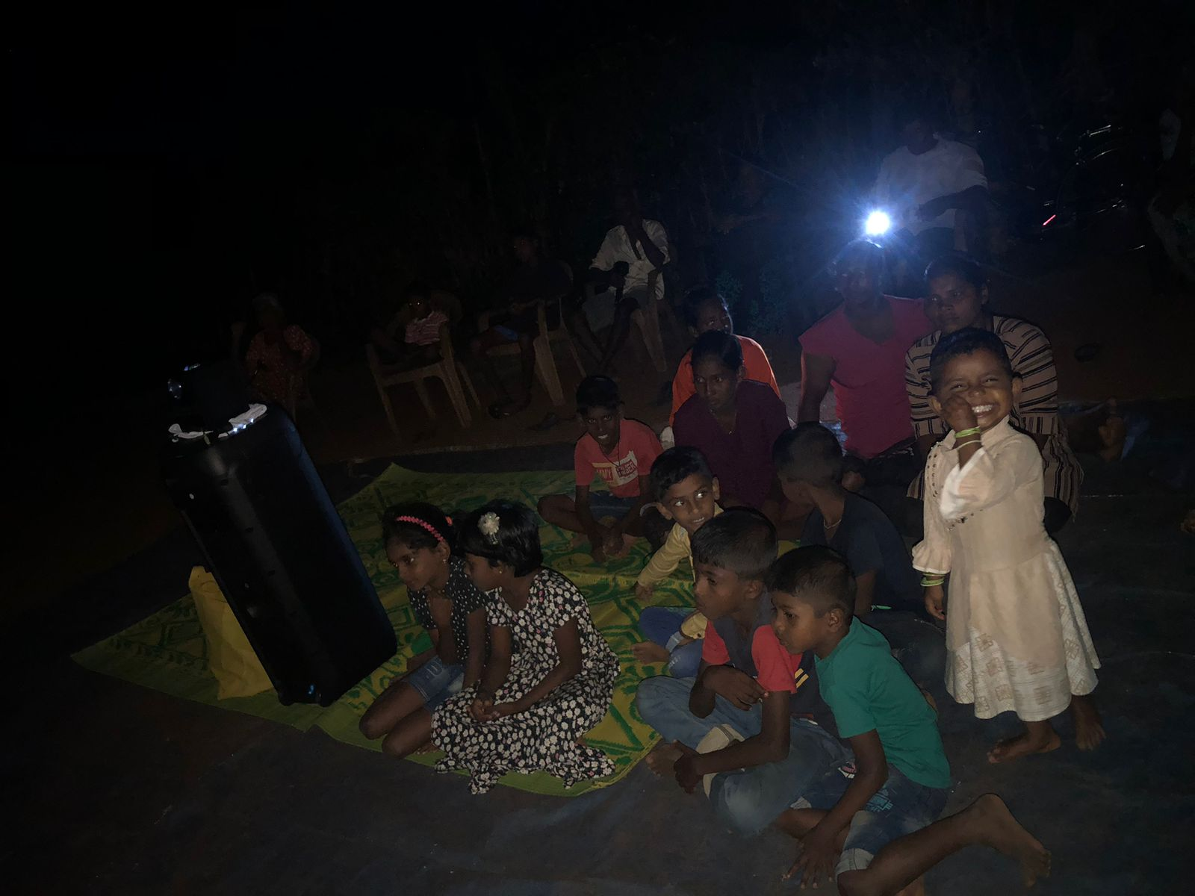
Outreach Ministries
Sri Lanka
April 2025

Slide 36
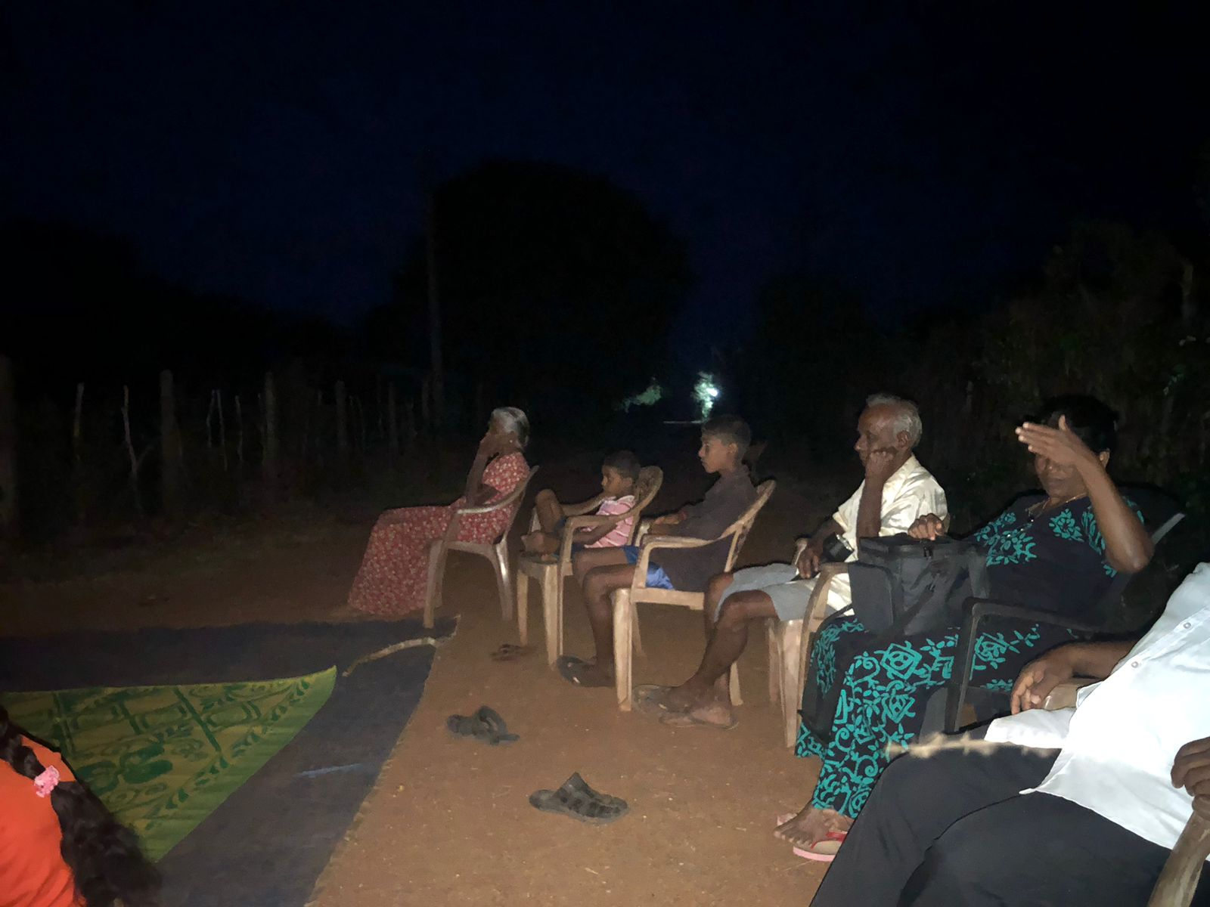
Outreach Ministries
Sri Lanka
April 2025

Slide 37
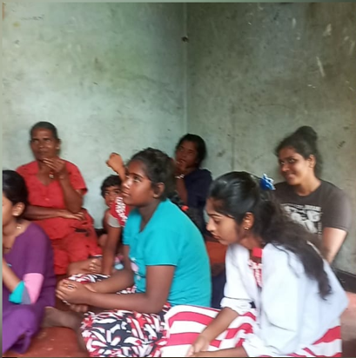
Outreach Ministries
Sri Lanka
April 2025

Slide 38
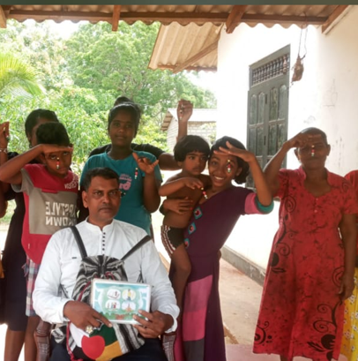
Outreach Ministries
Sri Lanka
April 2025

Slide 39
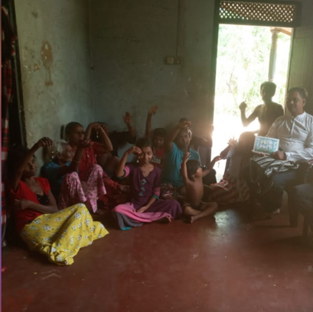
Outreach Ministries
Sri Lanka
April 2025

Slide 40
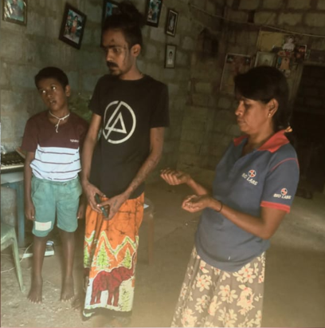
Outreach Ministries
Sri Lanka
April 2025

Slide 41
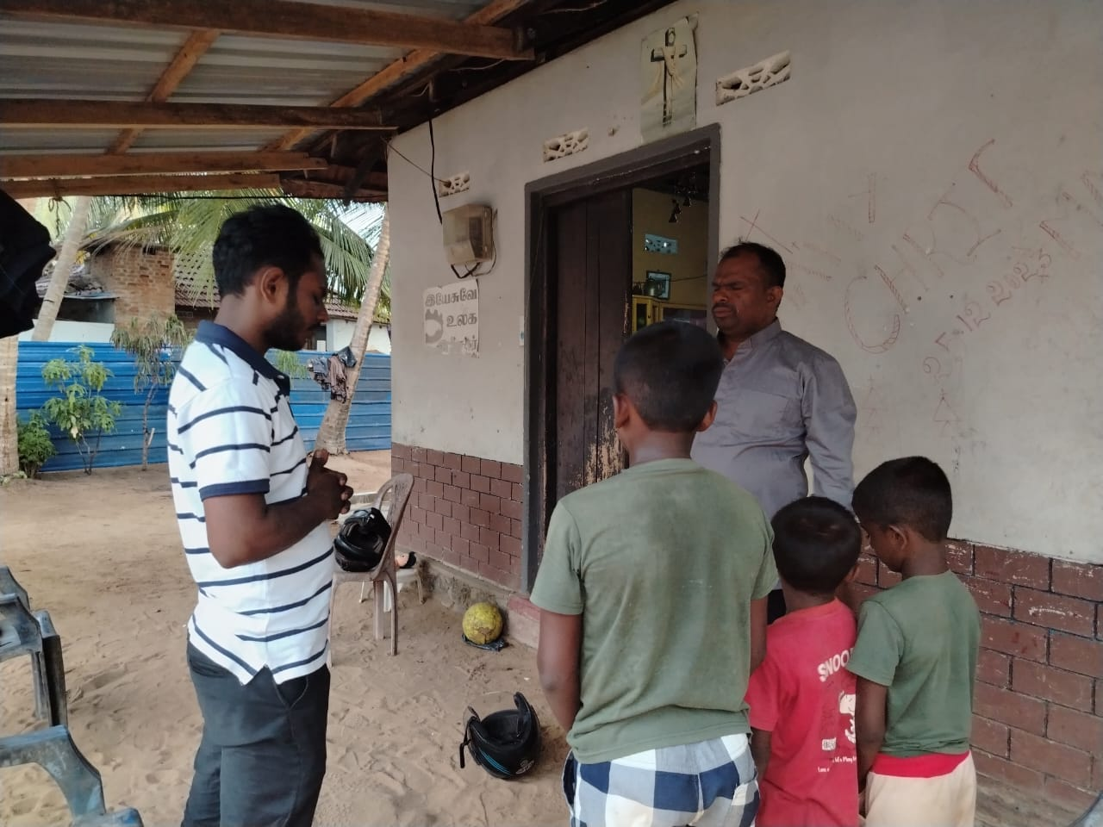
House Prayer
Sri Lanka
April 2025

Slide 42
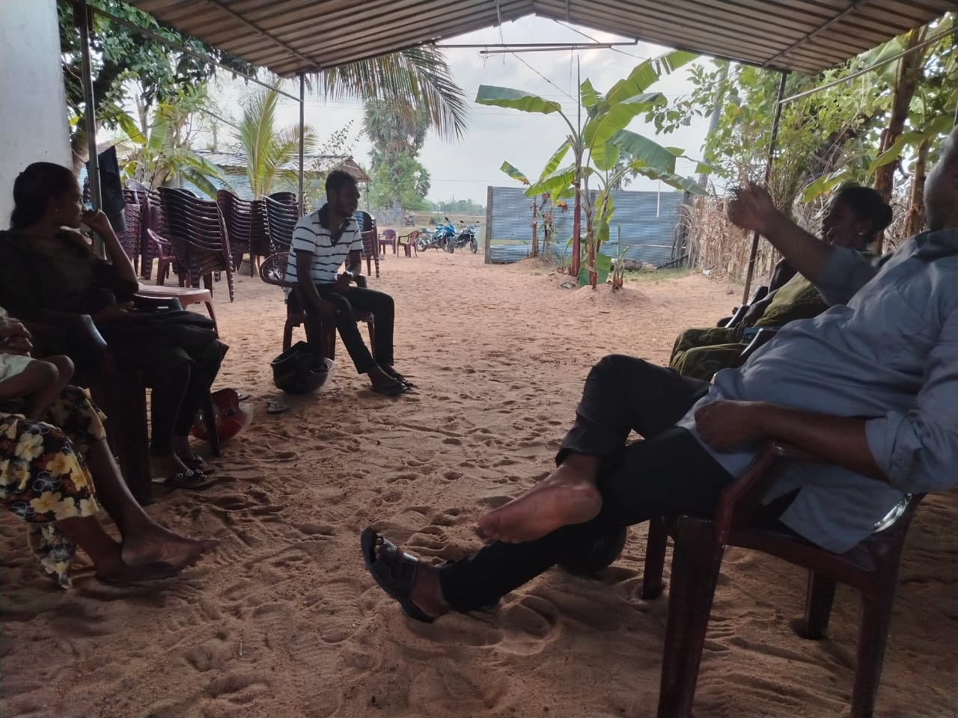
House Prayer
Sri Lanka
April 2025

Slide 43
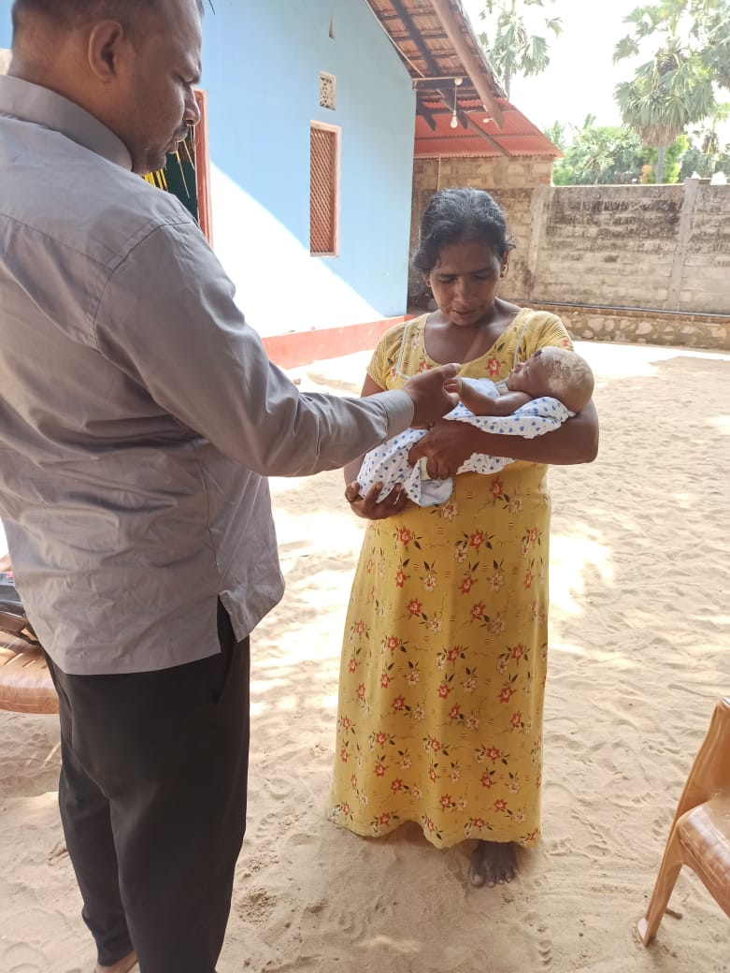
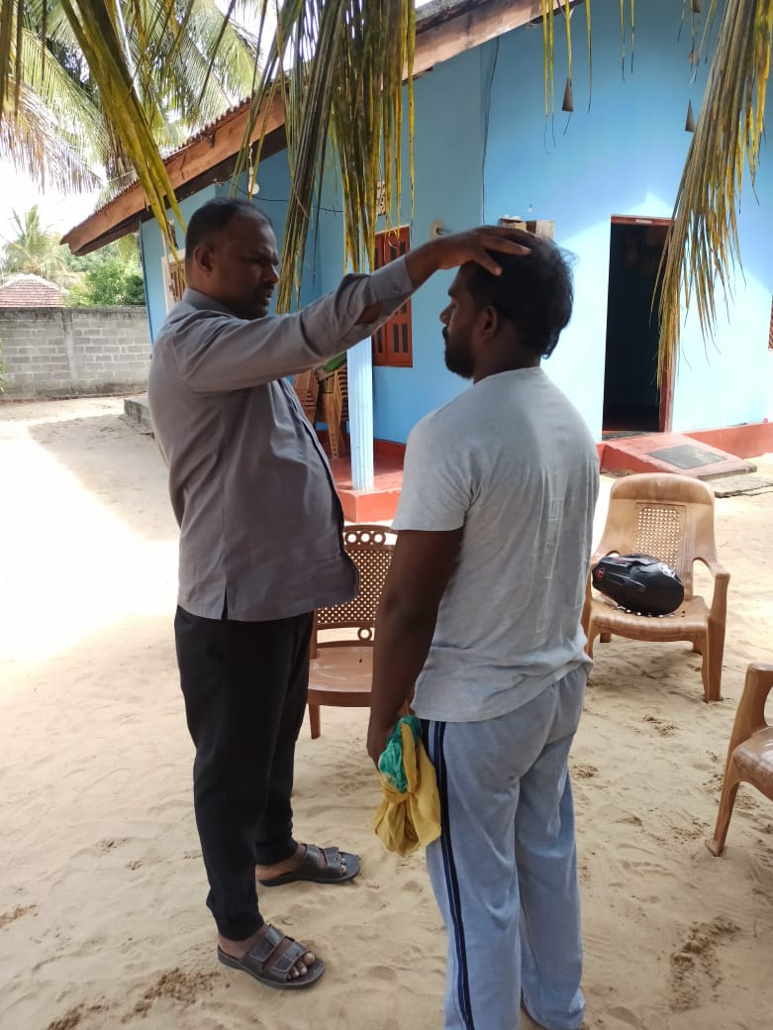
House Prayer
Sri Lanka
April 2025

Slide 44
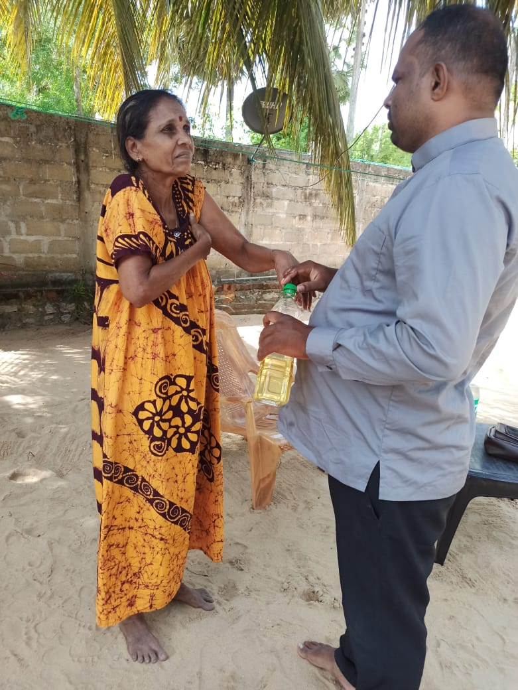

House Prayer
Sri Lanka
April 2025

Slide 45


House Prayer
Sri Lanka
April 2025

Slide 46


House Prayer
Sri Lanka
April 2025

Slide 47

House Prayer
Sri Lanka
April 2025

Slide 48


House Prayer
Sri Lanka
April 2025

Slide 49

Kids Ministry
Sri Lanka
April 2025

Slide 50

Kids Ministry
Sri Lanka
April 2025

Slide 51

Kids Ministry
Sri Lanka
April 2025

Slide 52


New Ministry
Sri Lanka
April 2025

Slide 53

New Ministry
Sri Lanka
April 2025

Slide 54


New Support
Sri Lanka
April 2025

Slide 55

New Support
Sri Lanka
April 2025

Slide 56


New Support
Sri Lanka
April 2025

Slide 57


New Support
Sri Lanka
April 2025

Slide 58


New Support
Sri Lanka
April 2025

Slide 59


New Support
Sri Lanka
April 2025

Slide 60

New Support
Sri Lanka
April 2025

Slide 61

Anniversary
Sri Lanka
April 2025

Slide 62

Anniversary
Sri Lanka
April 2025

Slide 63

Anniversary
Sri Lanka
April 2025

Slide 64

Sunday Worship
Sri Lanka
April 2025

Slide 65

Sunday Worship
Sri Lanka
April 2025

Slide 66

Sunday Worship
Sri Lanka
April 2025

Slide 67

Sri Lanka
April 2025

Slide 68

Sri Lanka
April 2025

Slide 69

Sri Lanka
April 2025

Slide 70

Sunday Worship
Sri Lanka
April 2025

Slide 71

Sunday Worship
Sri Lanka
April 2025

Slide 72

Sunday Worship
Sri Lanka
April 2025

Slide 73

Sunday Worship
Sri Lanka
April 2025

Slide 74

Sunday Worship
Sri Lanka
April 2025

Slide 75

Sunday Worship
Sri Lanka
April 2025

Slide 76

Sunday Worship
Sri Lanka
April 2025

Slide 77

Sunday Worship
Sri Lanka
April 2025

Slide 78

Sunday Worship
Sri Lanka
April 2025

Slide 79

Sunday Worship
Sri Lanka
April 2025

Slide 80

Sunday Worship
Sri Lanka
April 2025

Slide 81

Sunday Worship
Sri Lanka
April 2025

Slide 82

Sunday Worship
Sri Lanka
April 2025

Slide 83

Sunday Worship
Sri Lanka
April 2025

Slide 84

Sunday Worship
Sri Lanka
April 2025

Slide 85

Sunday Worship
Sri Lanka
April 2025

Slide 86

Sunday Worship
Sri Lanka
April 2025

Slide 87

Sunday Worship
Sri Lanka
April 2025

Slide 88

Sunday Worship
Sri Lanka
April 2025

Slide 89

Sunday Worship
Sri Lanka
April 2025

Slide 90

Sunday Worship
Sri Lanka
April 2025

Slide 91

Sunday Worship
Sri Lanka
April 2025

Slide 92

Sunday Worship
Sri Lanka
April 2025

Slide 93

Sunday Worship
Sri Lanka
April 2025

Slide 94

Sunday Worship
Sri Lanka
April 2025

Slide 95

Sunday Worship
Sri Lanka
April 2025

Slide 96

Sunday Worship
Sri Lanka
April 2025

Slide 97

Sunday Worship
Sri Lanka
April 2025

Slide 98

Sunday Worship
Sri Lanka
April 2025

Slide 99

Sunday Worship
Sri Lanka
April 2025

Slide 100
Prayer Points
Church Ministry & Outreach – Pray for the continued success of evangelism efforts, outreach ministries, and the expansion of God’s kingdom in these mission fields.
New Believers & Baptisms – Pray for the individuals who have been baptized, that they remain strong in their faith and become active in their churches.
Mission Fields – Pray for the mission fields where pastors and church leaders are ministering, that they may bear fruit and bring more souls to Christ.
Pastors – Pray for the 19 pastors who are working in these areas, that they remain encouraged and steadfast in their ministry.
Church Construction – Pray for the construction needs of the Church in Trincomalee
Social Upliftment - Pray for the social upliftment of the mission team and their families and the communities where our mission activities take place
Sri Lanka
April 2025

